Slide 1

PART II – Analysis Tool

Slide 2
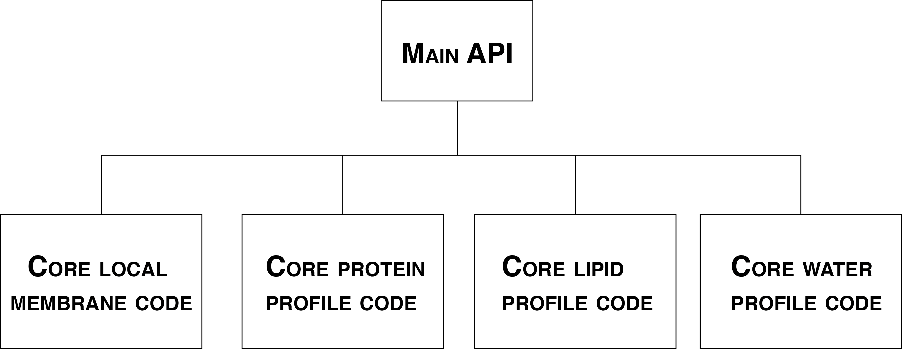
Motivation

Slide 3
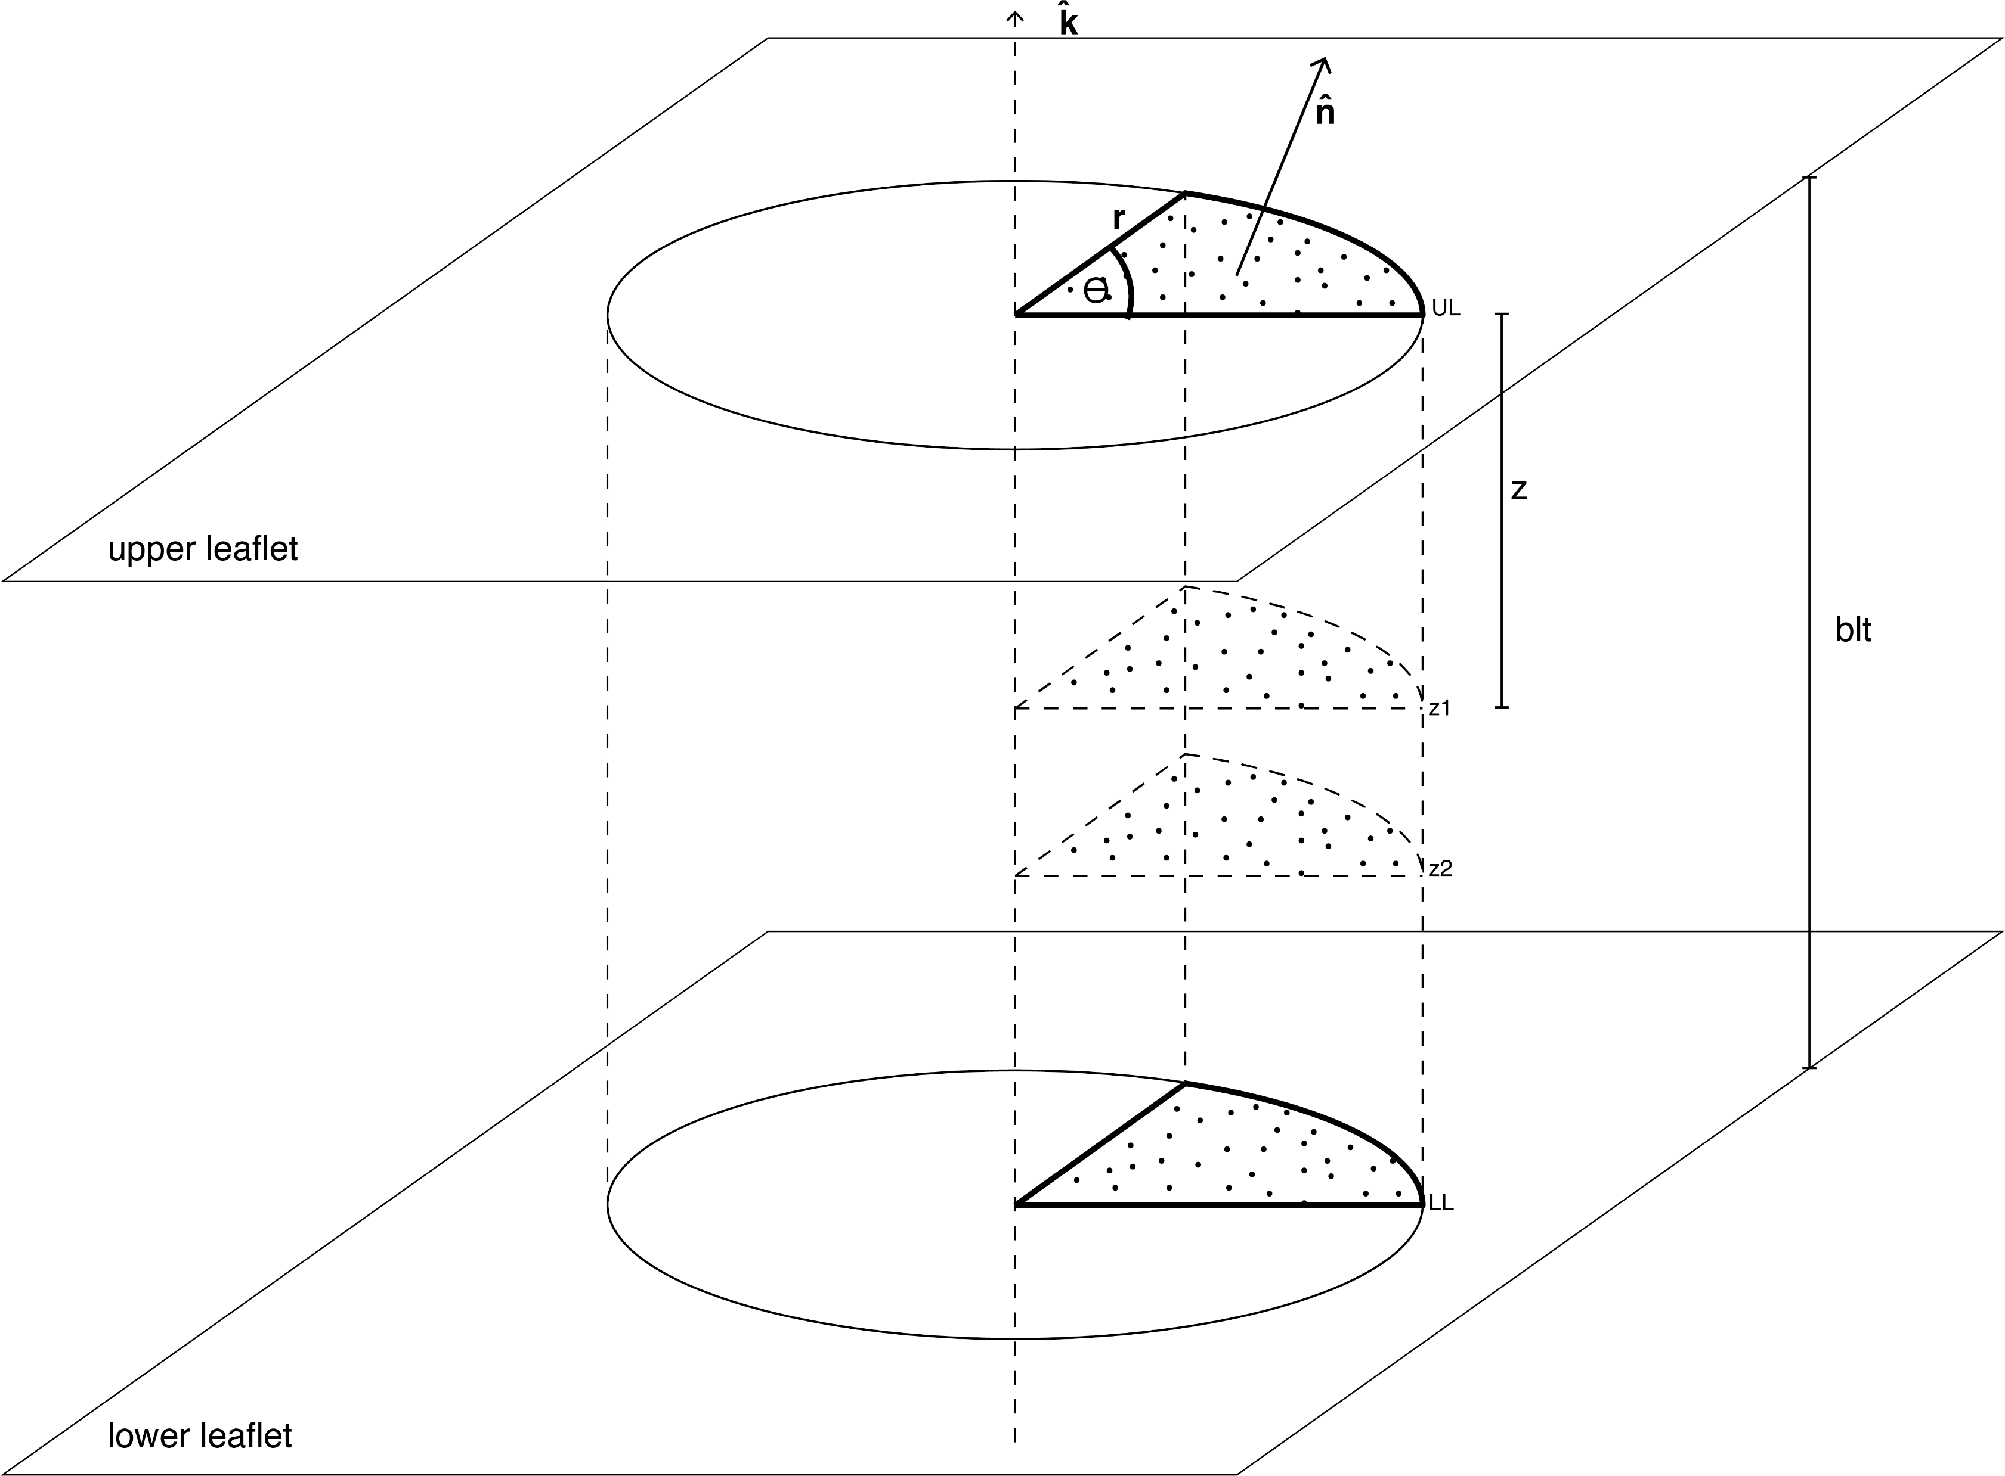
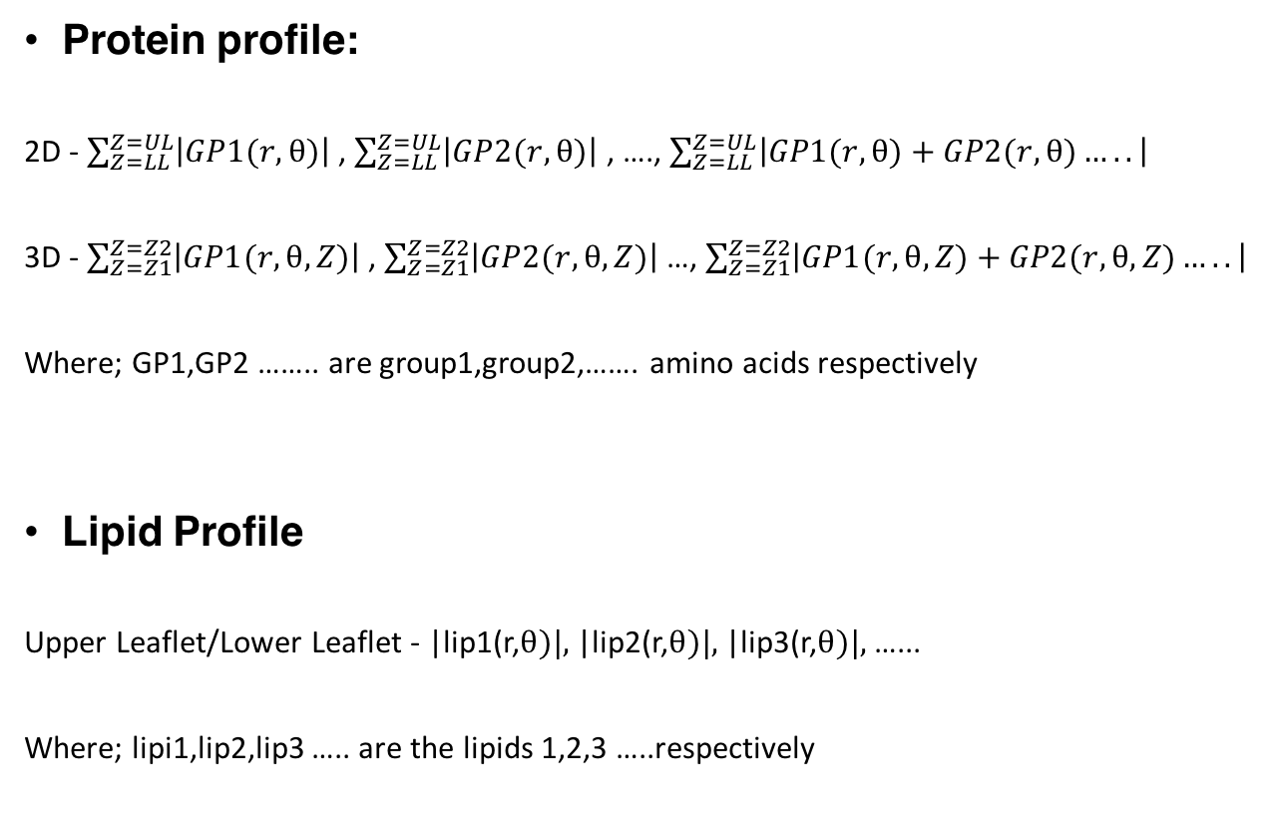
Motivation
Protein profile:
2D - $\sum_{Z=LL}^{Z=UL}{\left|GP1(r,θ)\right|}$ , $\sum_{Z=LL}^{Z=UL}{\left|GP2(r,θ)\right|}$ , …., $\sum_{Z=LL}^{Z=UL}{\left|GP1(r,θ)+GP2(r,θ)…..\right|}$
3D - $\sum_{Z=Z1}^{Z=Z2}{\left|GP1(r,θ,Z)\right|}$ , $\sum_{Z=Z1}^{Z=Z2}{\left|GP2(r,θ,Z)\right|}$ …, $\sum_{Z=Z1}^{Z=Z2}{\left|GP1(r,θ,Z)+GP2(r,θ,Z)…..\right|}$
Where; GP1,GP2 …….. are group1,group2,……. amino acids respectively
Lipid Profile
Upper Leaflet/Lower Leaflet - |lip1(r,$θ)|,$|lip2(r,$θ)|,$|lip3(r,$θ)|,$ …...
Where; lipi1,lip2,lip3 ….. are the lipids 1,2,3 …..respectively

Slide 4
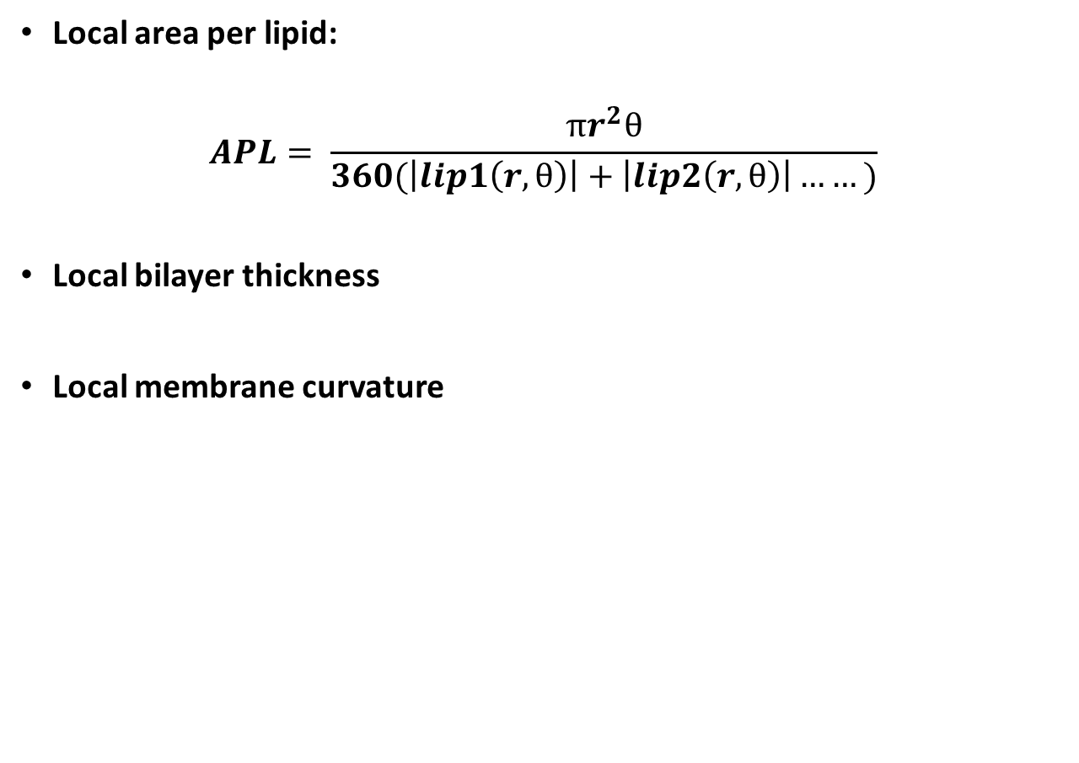
Motivation
Local area per lipid:
$$APL= \frac{πr^{2}θ}{360(\left|lip1\left(r,θ\right)\right|+\left|lip2\left(r,θ\right)\right|……)}$$
Local bilayer thickness
Local membrane curvature

Slide 5
Protein Profiles

Slide 6
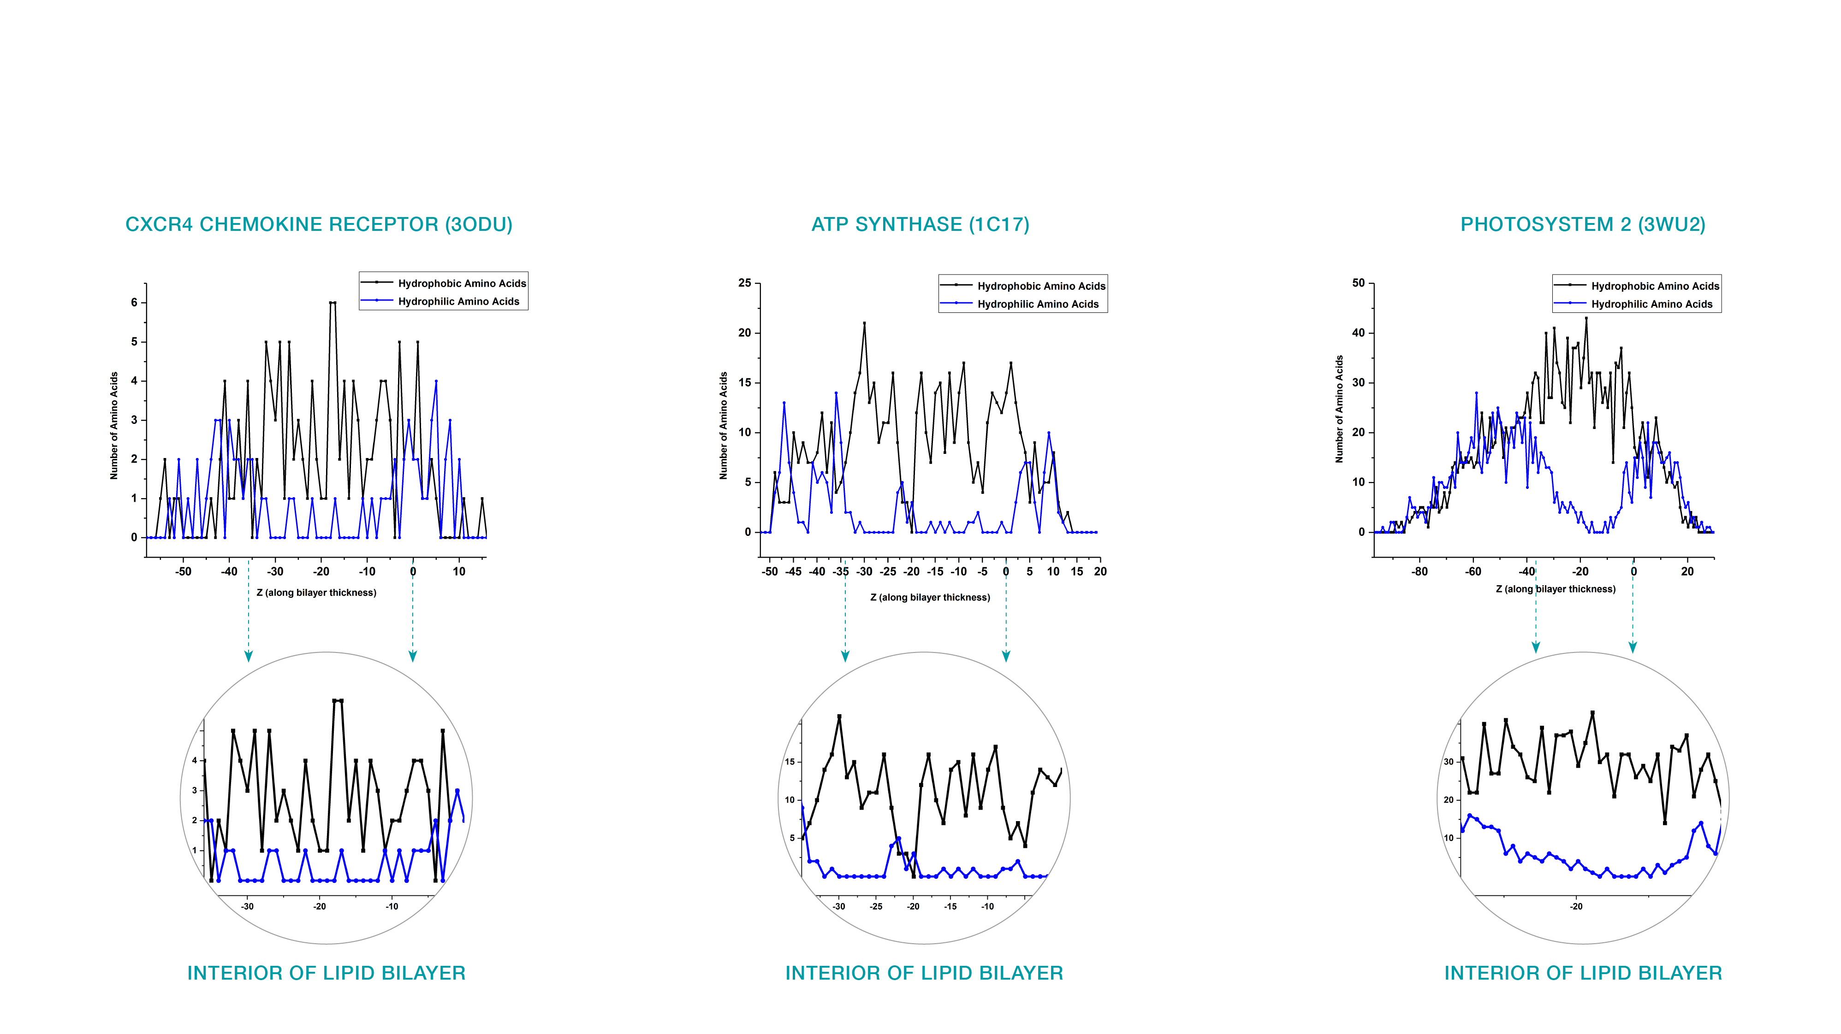
1 Dimensional Protein Profile

Slide 7
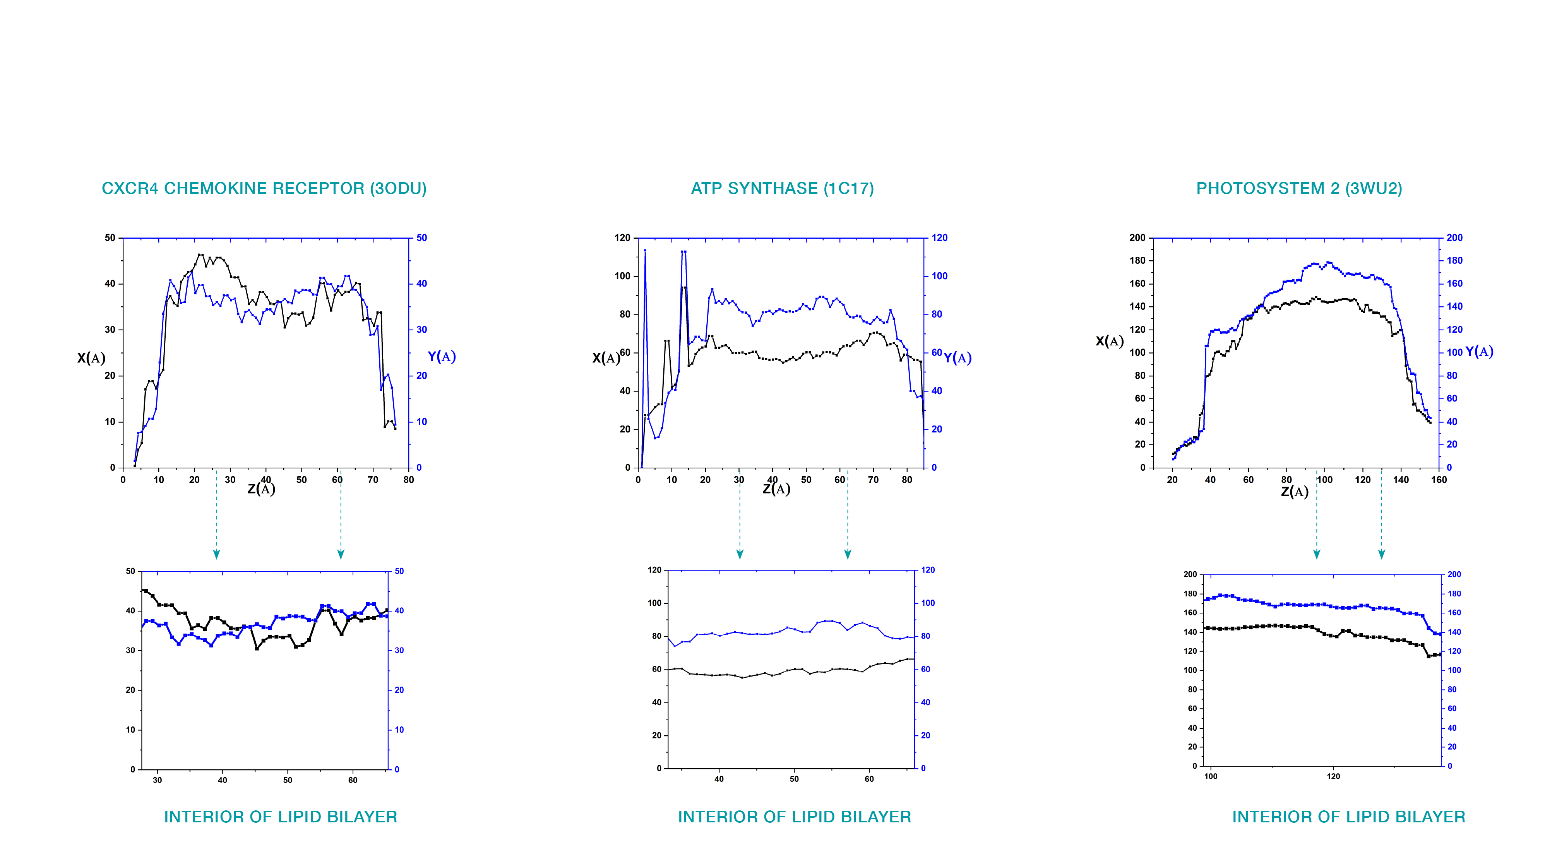
2 Dimensional Protein Profile (Spread)

Slide 8
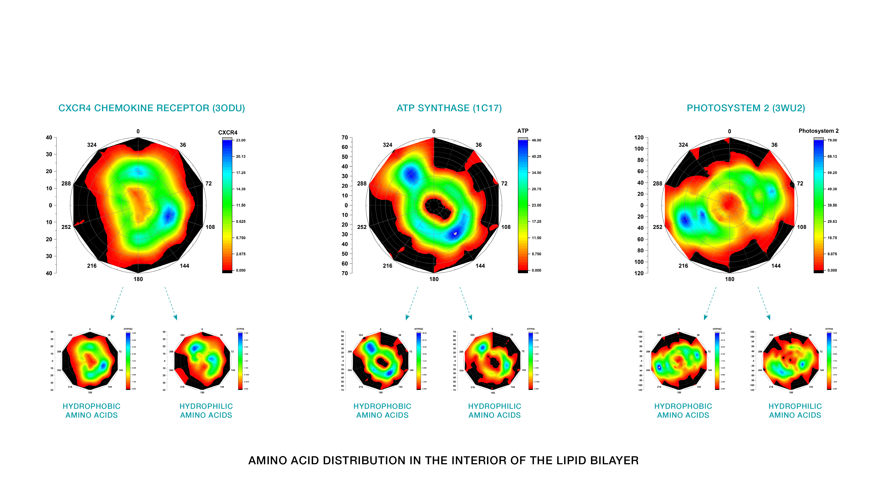
2 Dimensional Protein Profile (Amino Acid Distribution)

Slide 9
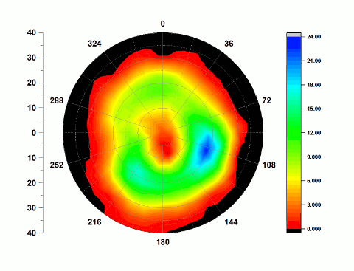
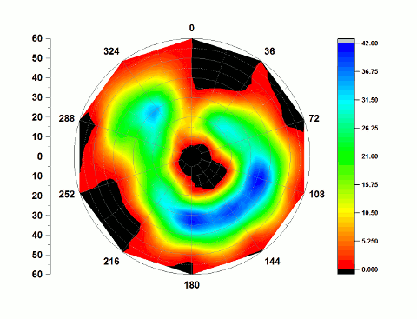
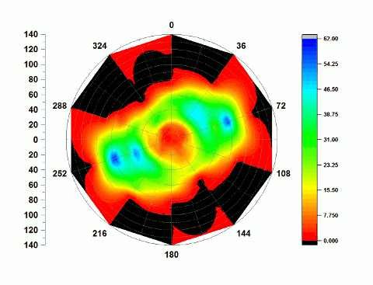
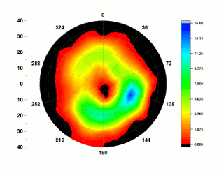
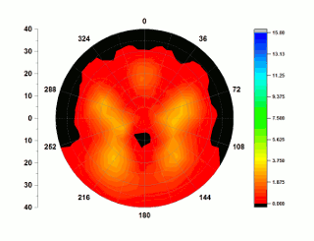
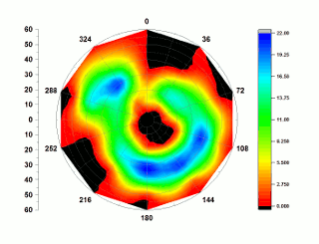
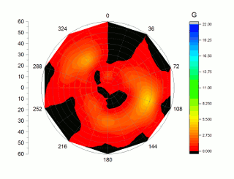
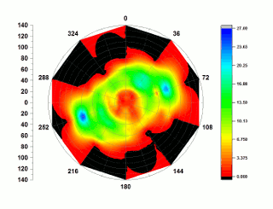
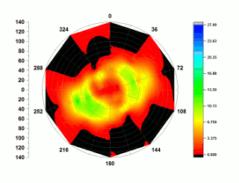
Protein structure evolution
CXCR4 CHEMOKINE RECEPTOR (3ODU)
ATP SYNTHASE (1C17)
PHOTOSYSTEM 2 ( 3WU2)
HYDROPHOBIC AMINO ACIDS
HYDROPHILIC AMINO ACIDS
HYDROPHOBIC AMINO ACIDS
HYDROPHILIC AMINO ACIDS
HYDROPHOBIC AMINO ACIDS
HYDROPHILIC AMINO ACIDS

Slide 10
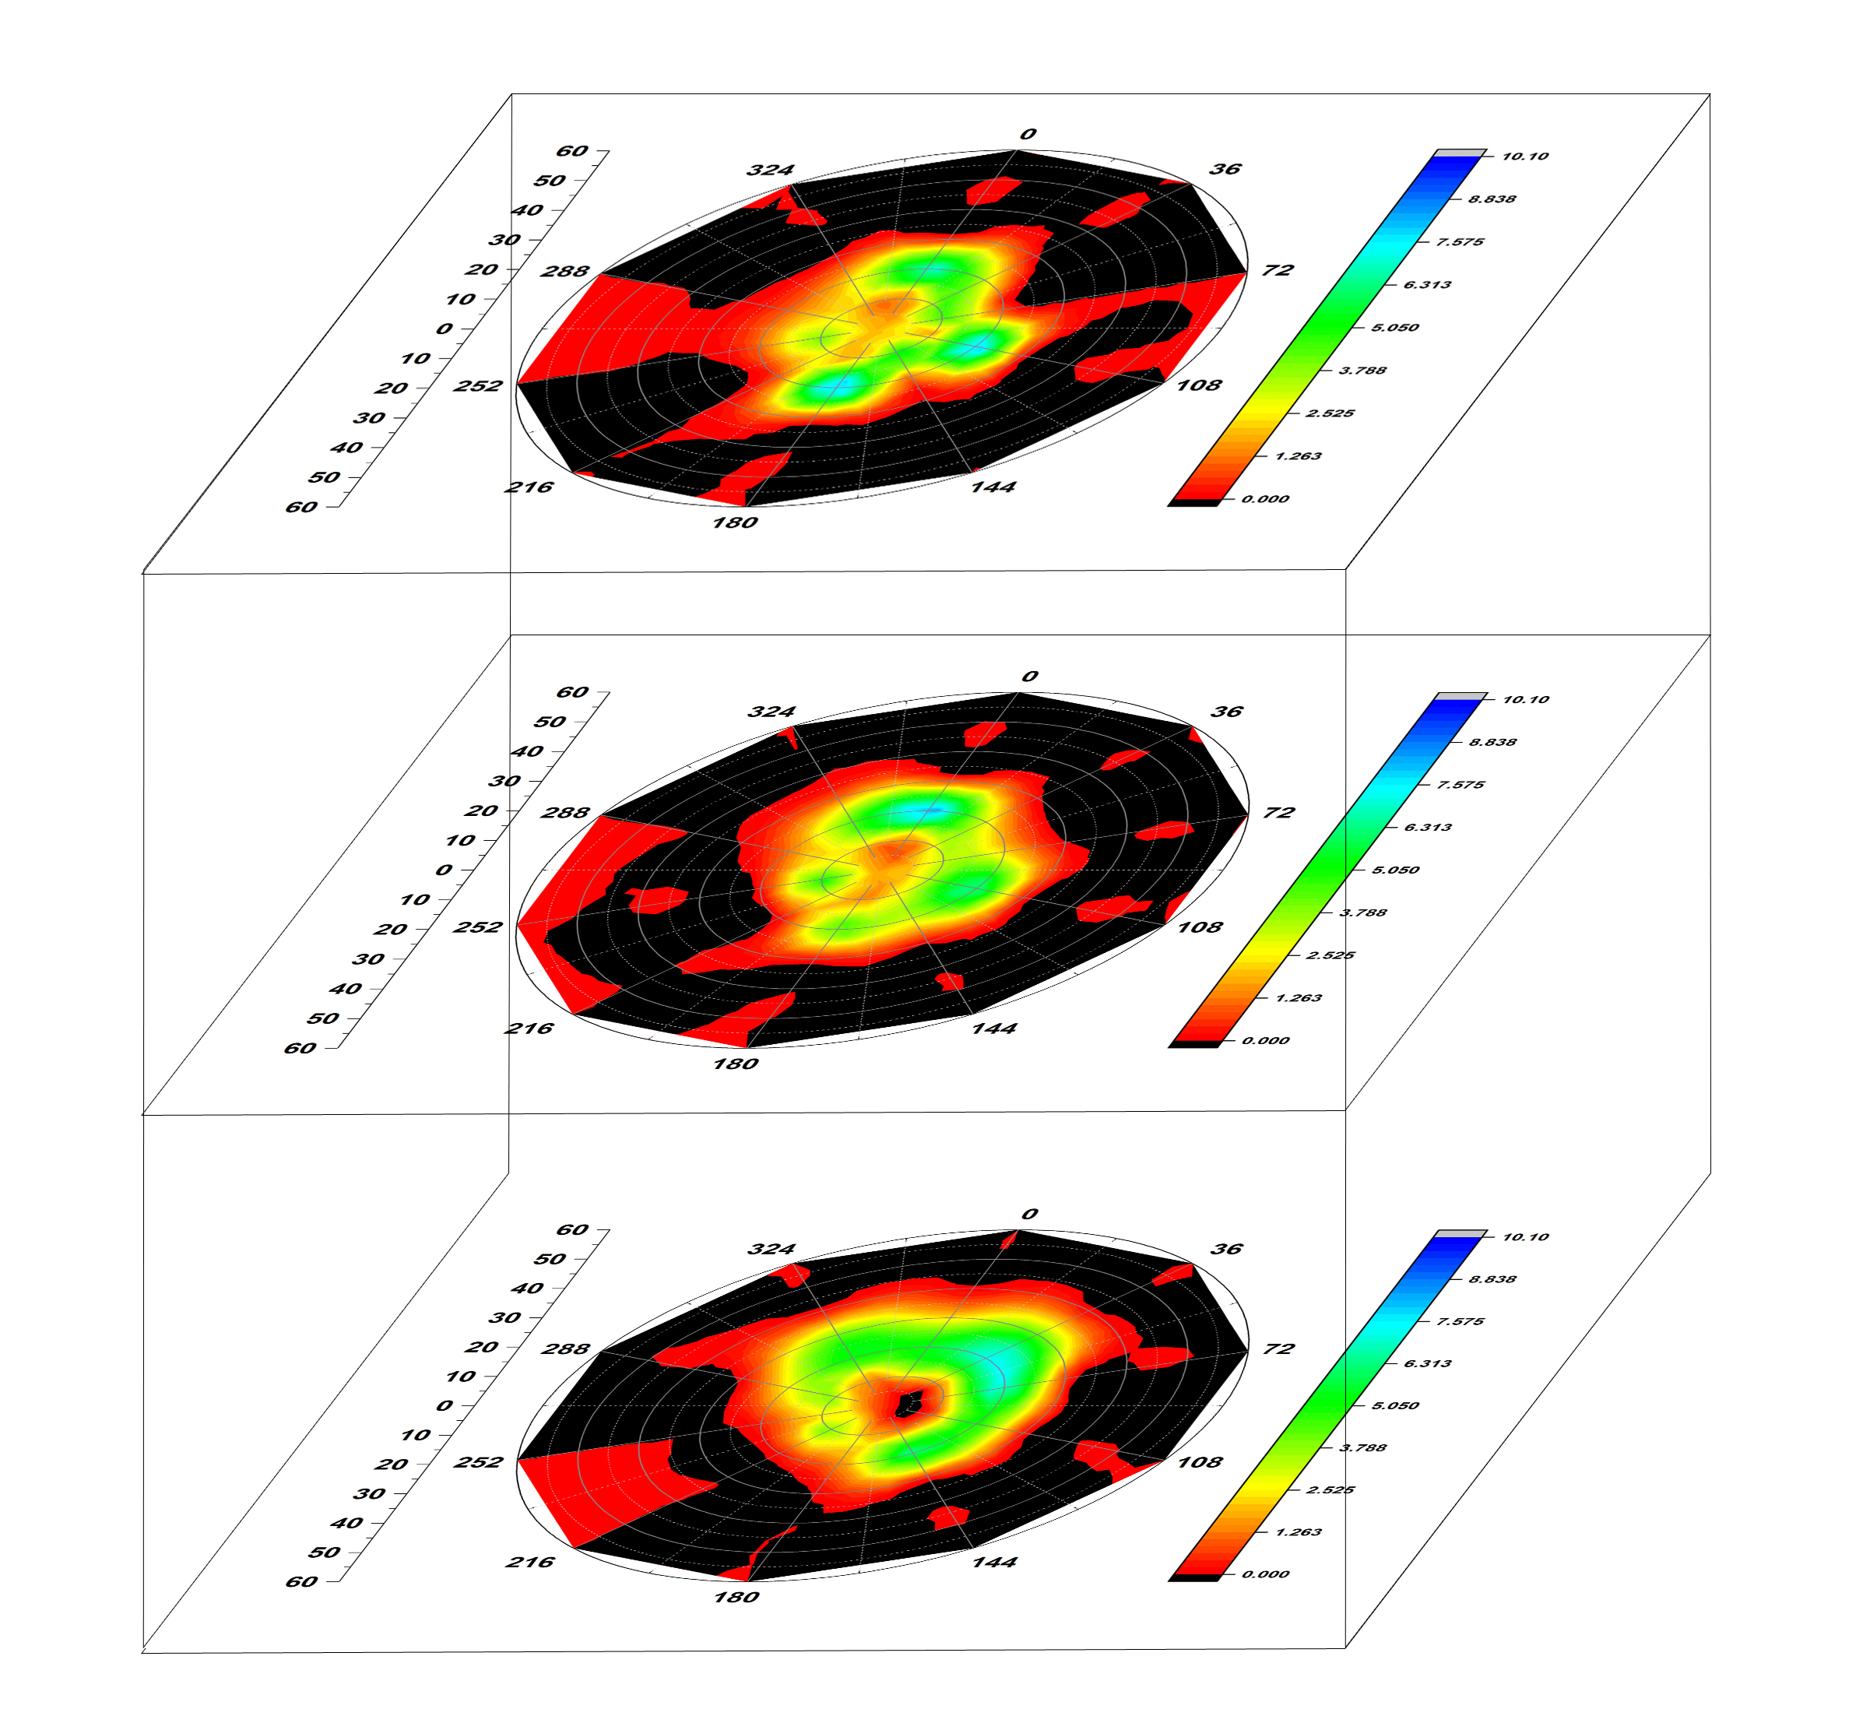
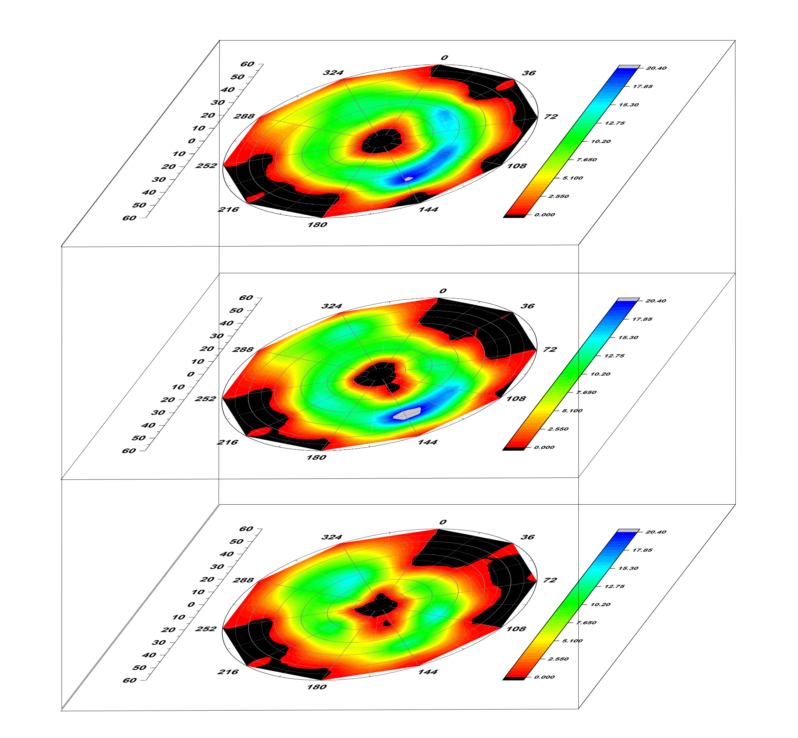
3 Dimensional Protein Profile (Amino Acid Distribution)
CXCR4 CHEMOKINE RECEPTOR (3ODU)
ATP SYNTHASE (1C17)
PHOTOSYSTEM 2 ( 3WU2)

Slide 11
Lipid Profiles

Slide 12
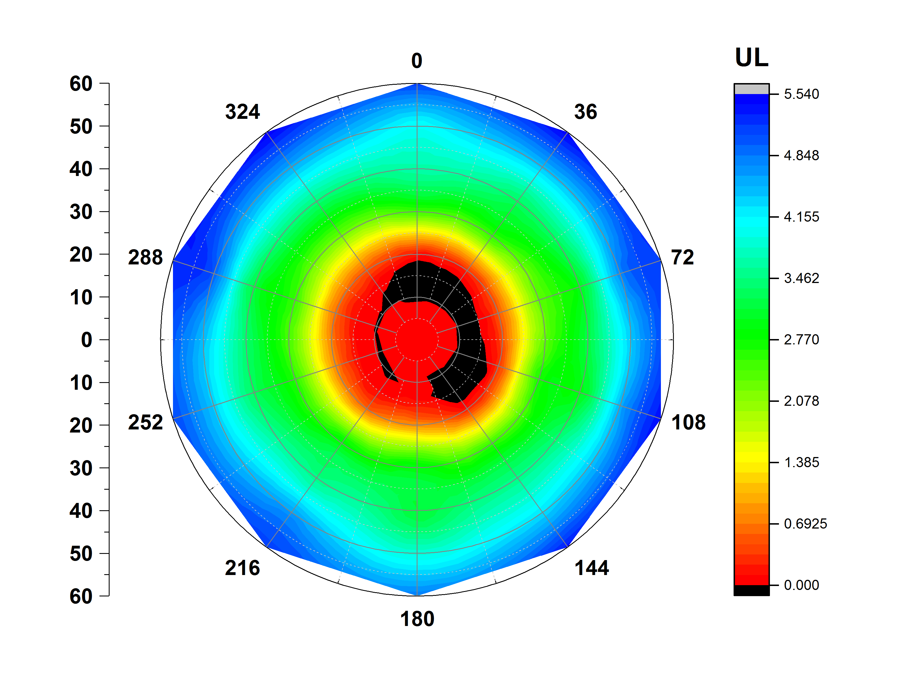
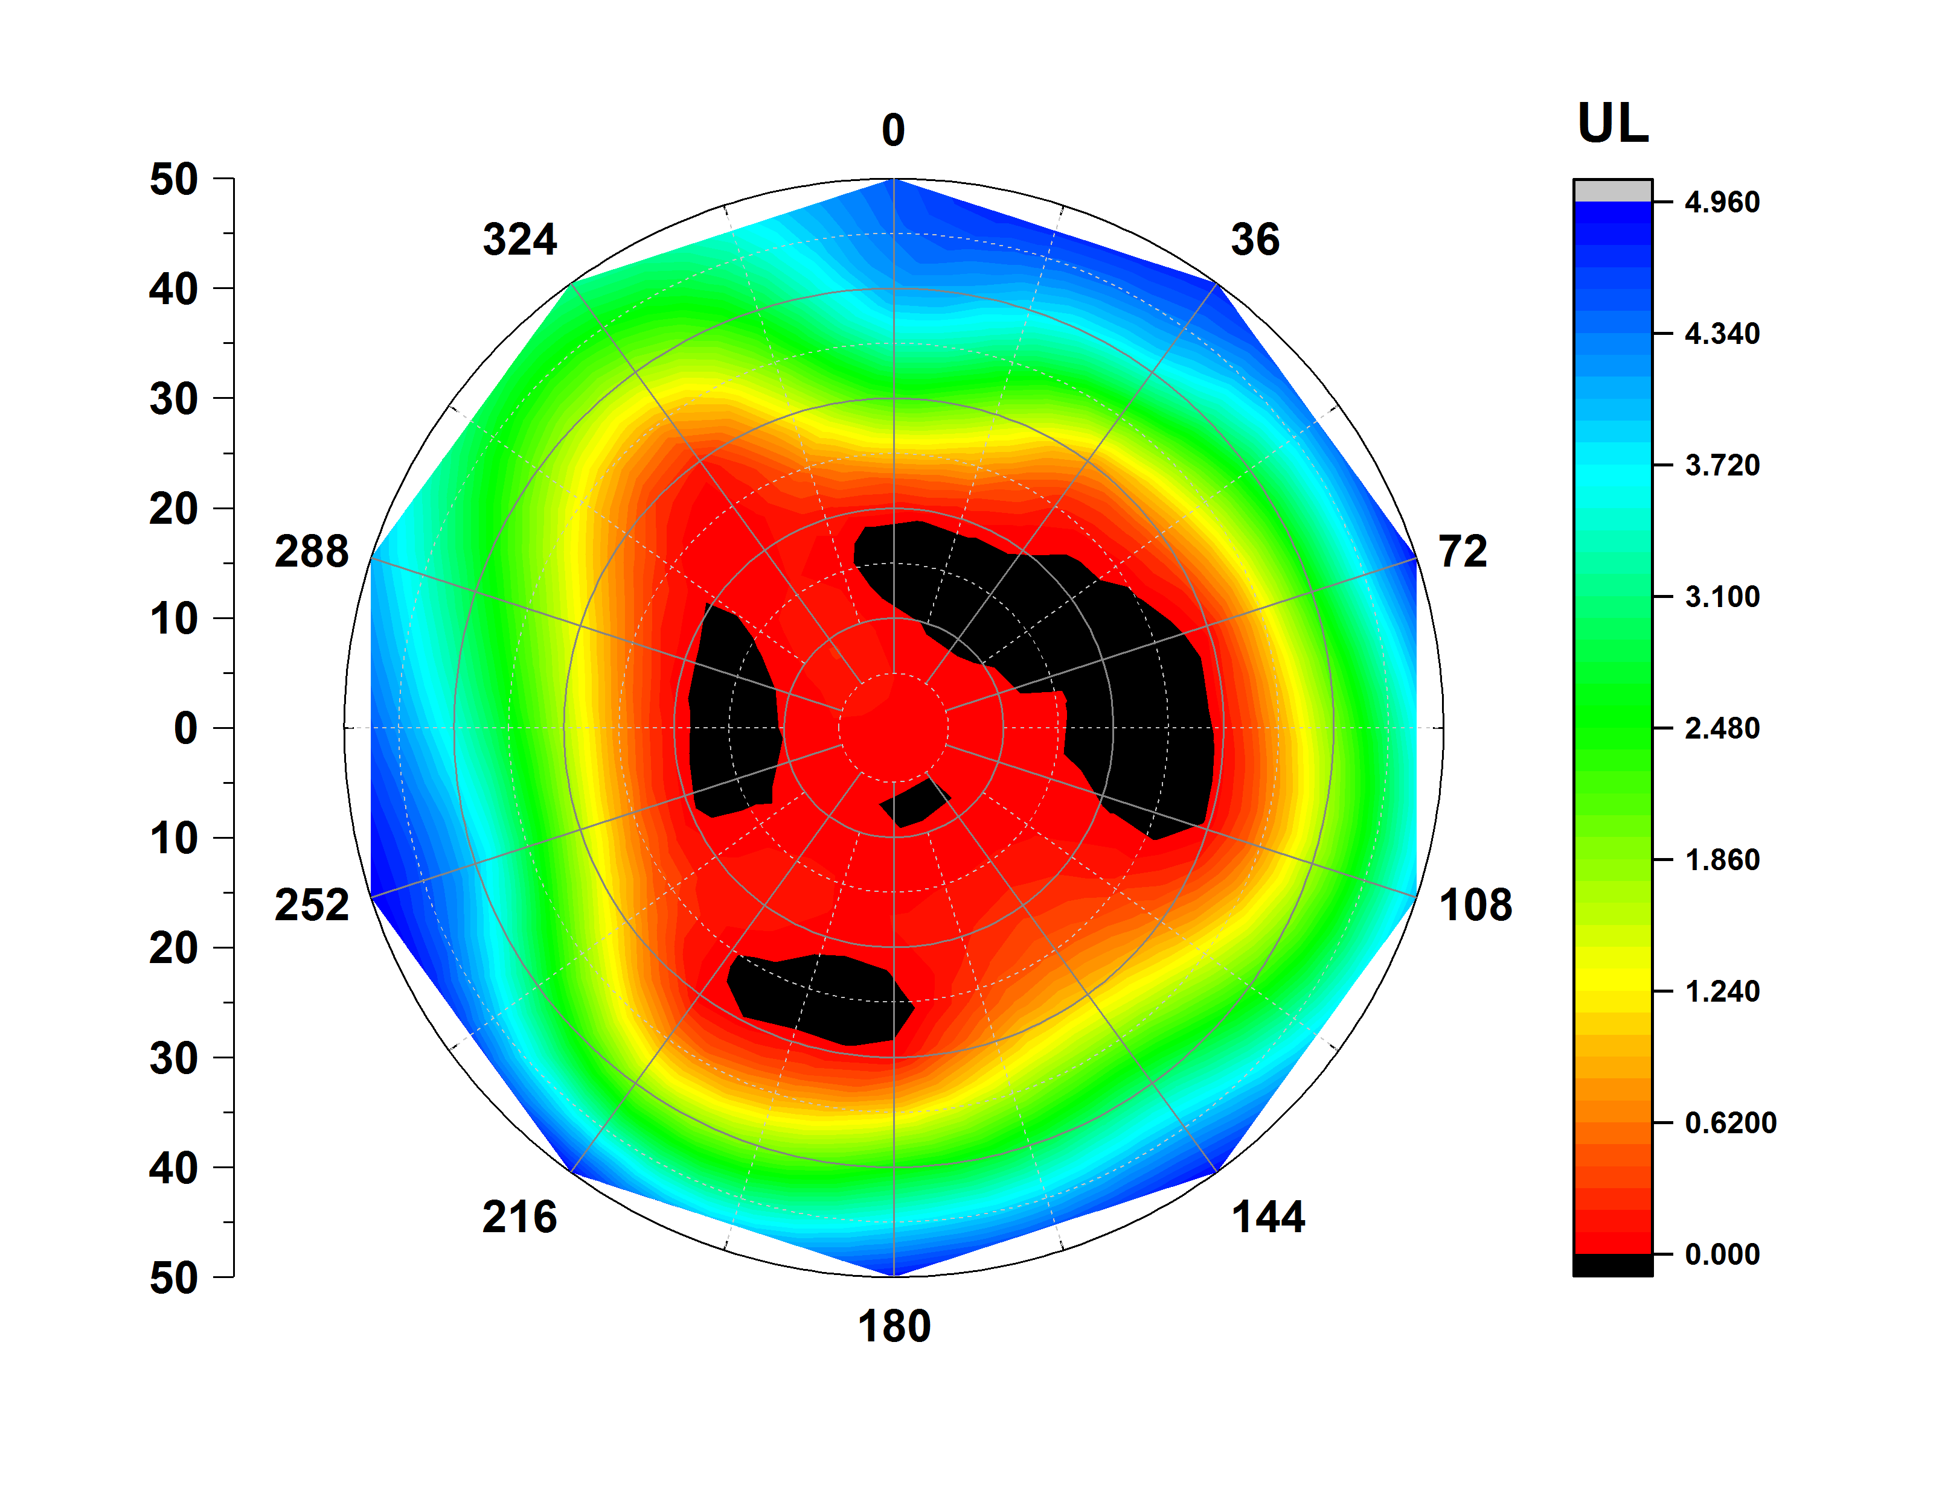
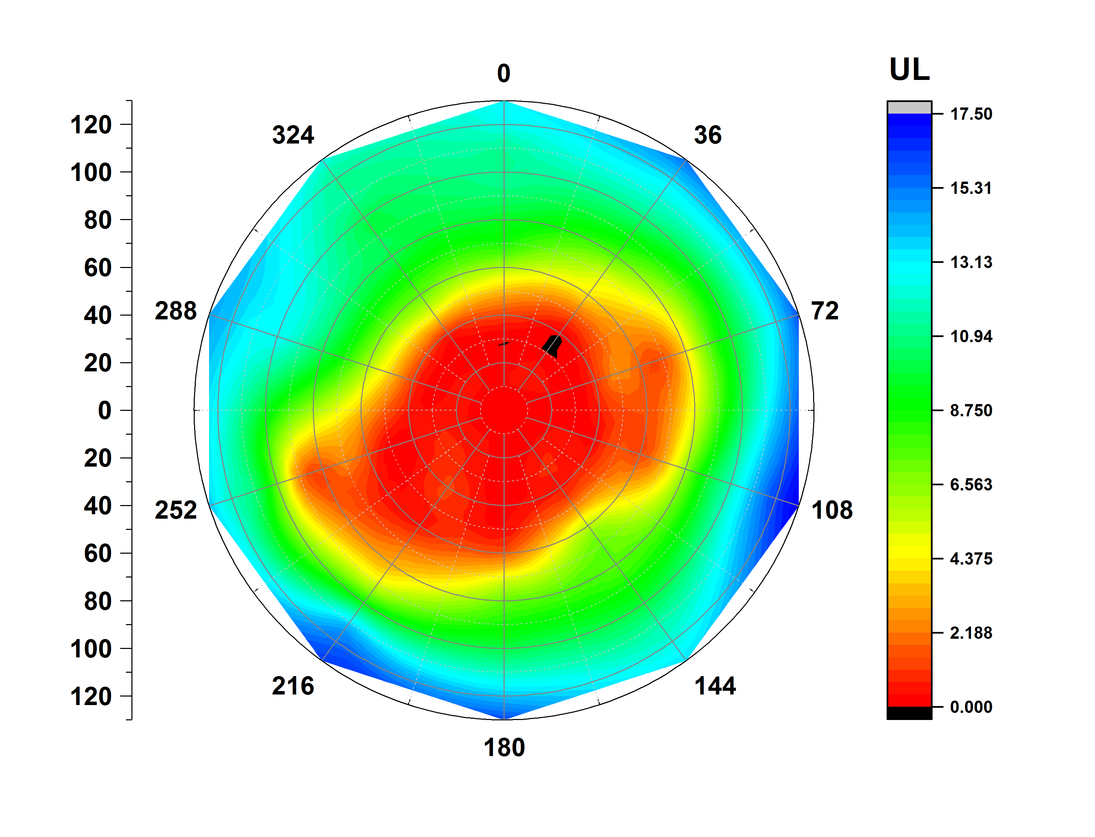
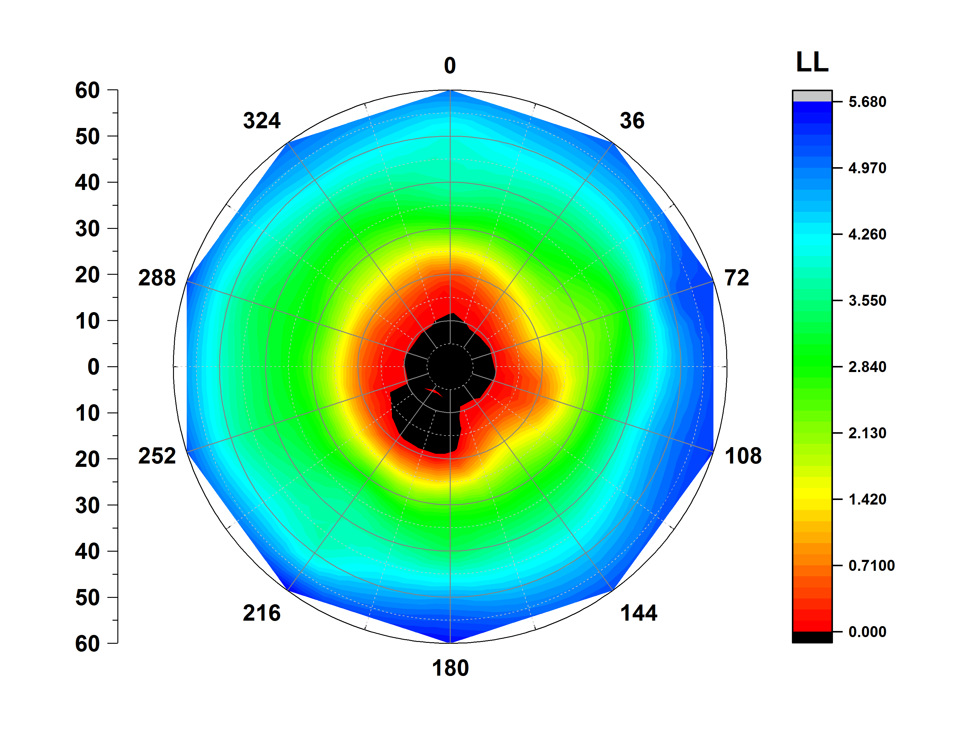
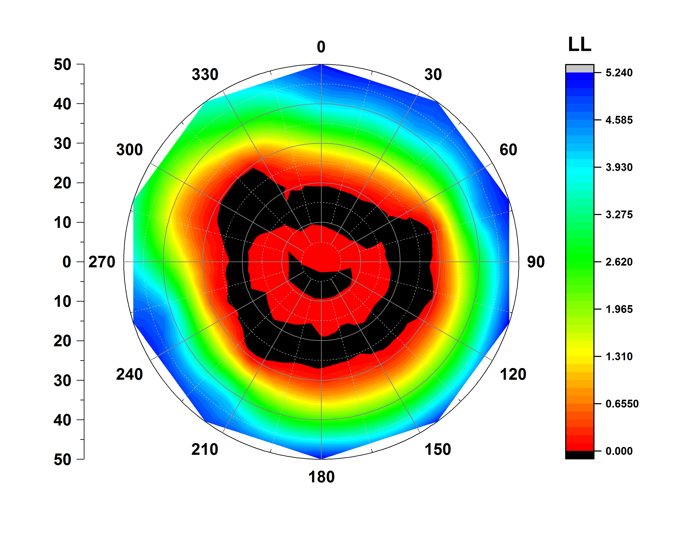
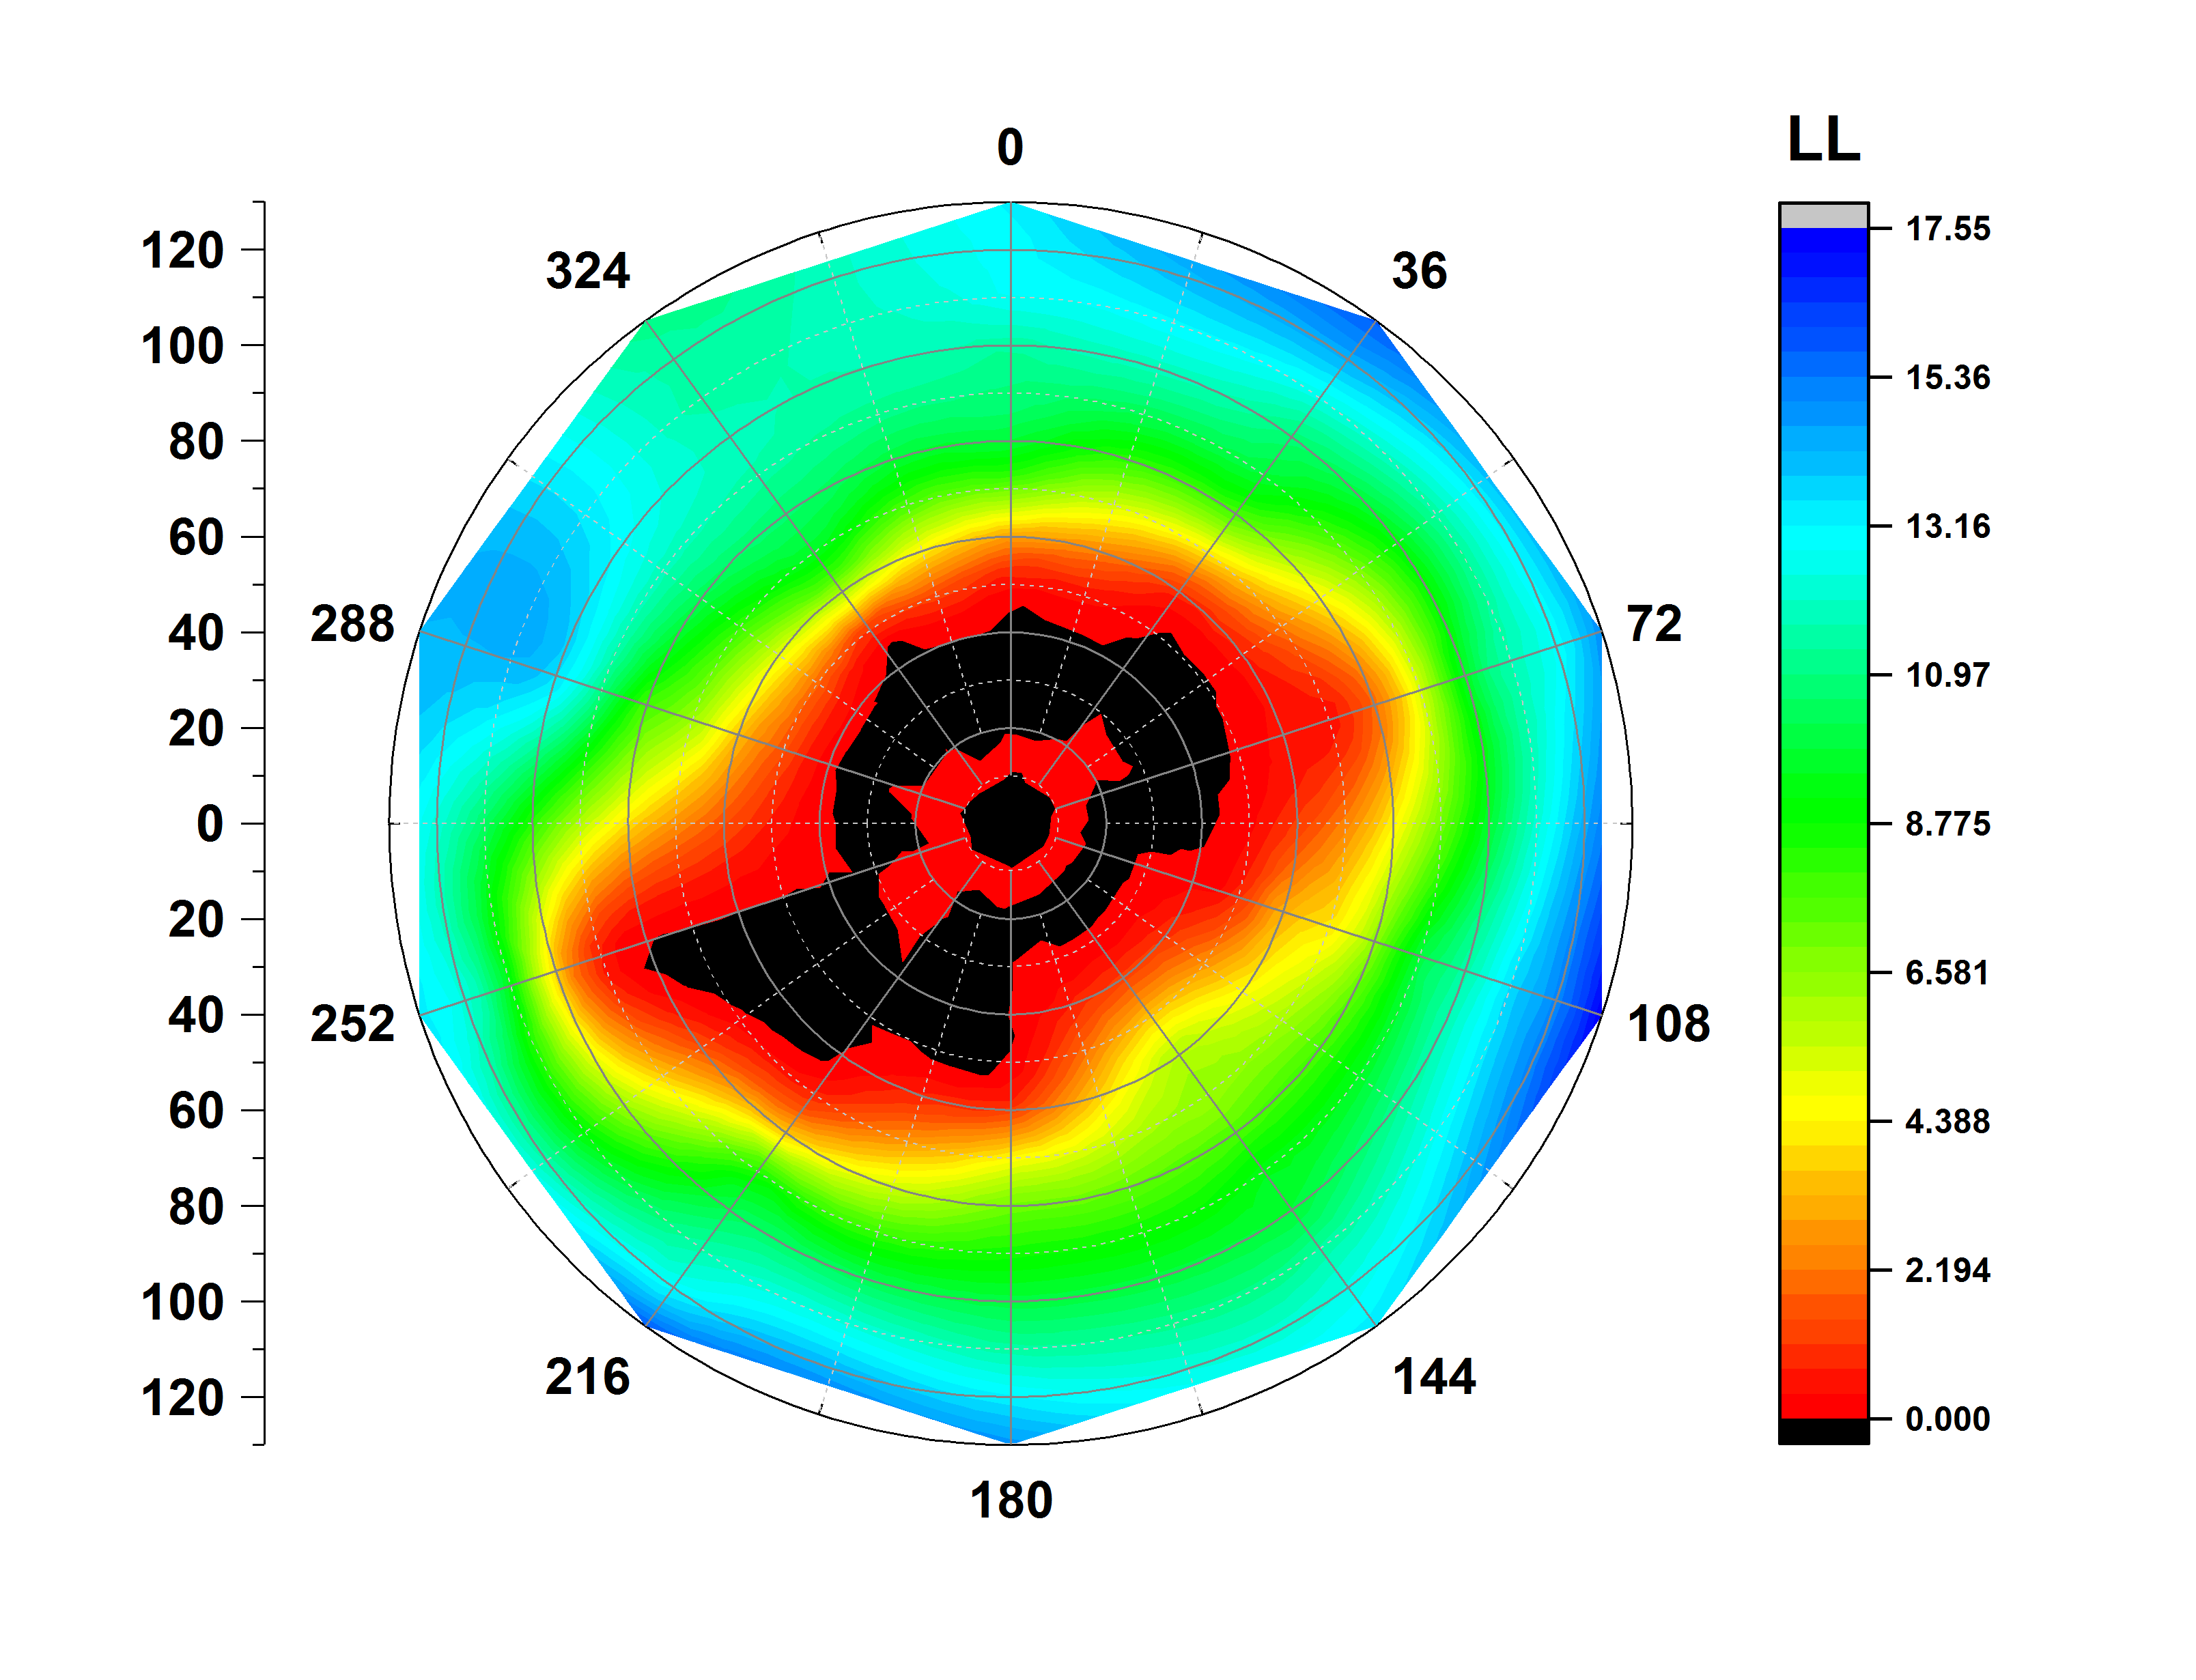
Lipid profile in contrast to protein profile
CXCR4 CHEMOKINE RECEPTOR (3ODU)
ATP SYNTHASE (1C17)
PHOTOSYSTEM 2 ( 3WU2)
UPPER LEAFLET
LOWER LEAFLET

Slide 13
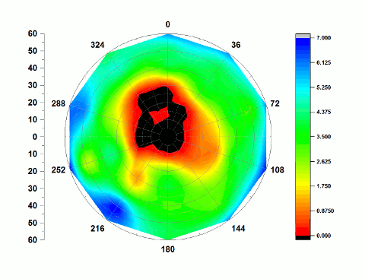
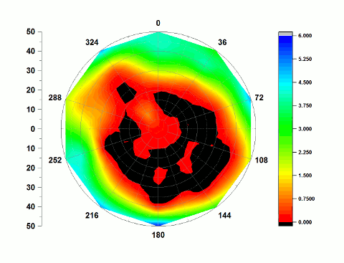
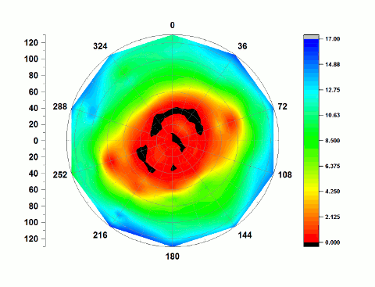
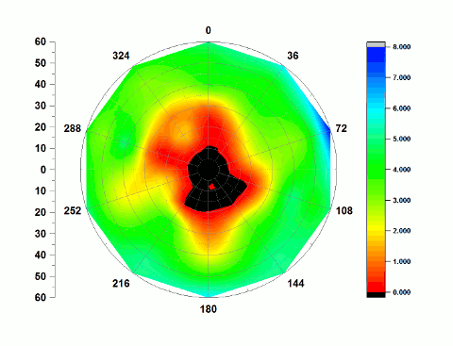
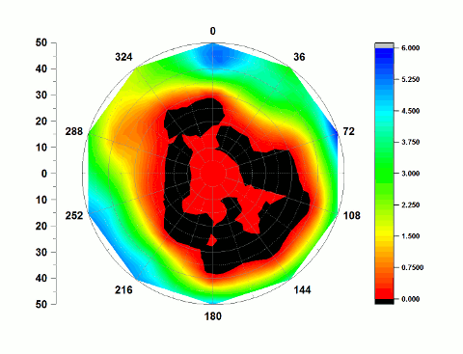
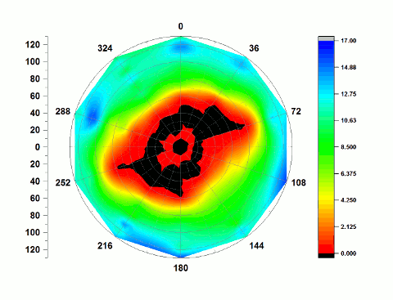
Lipid structure evolution
CXCR4 CHEMOKINE RECEPTOR (3ODU)
ATP SYNTHASE (1C17)
PHOTOSYSTEM 2 ( 3WU2)
UPPER LEAFLET
LOWER LEAFLET

Slide 14
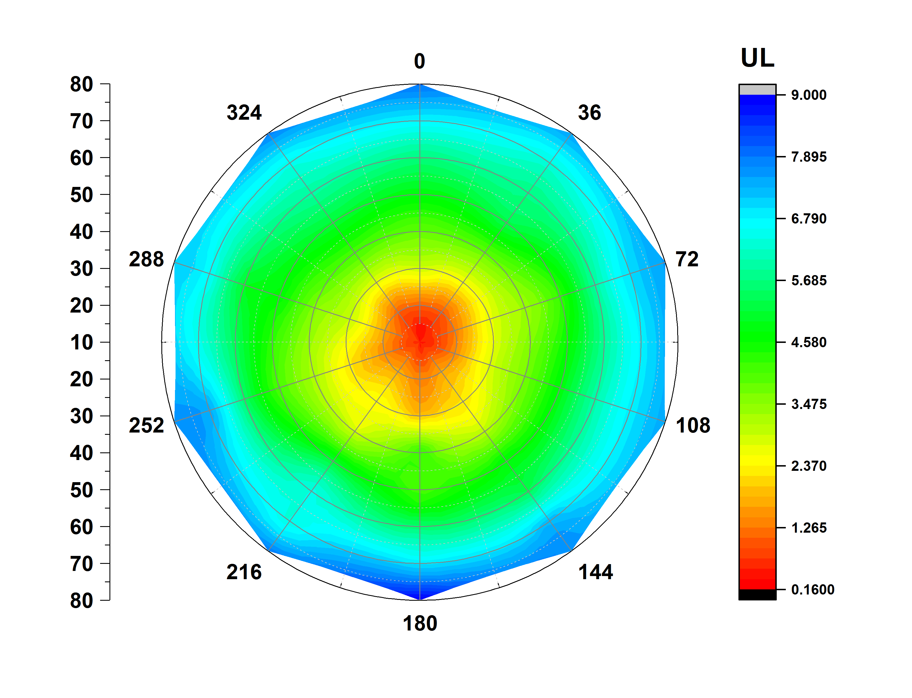
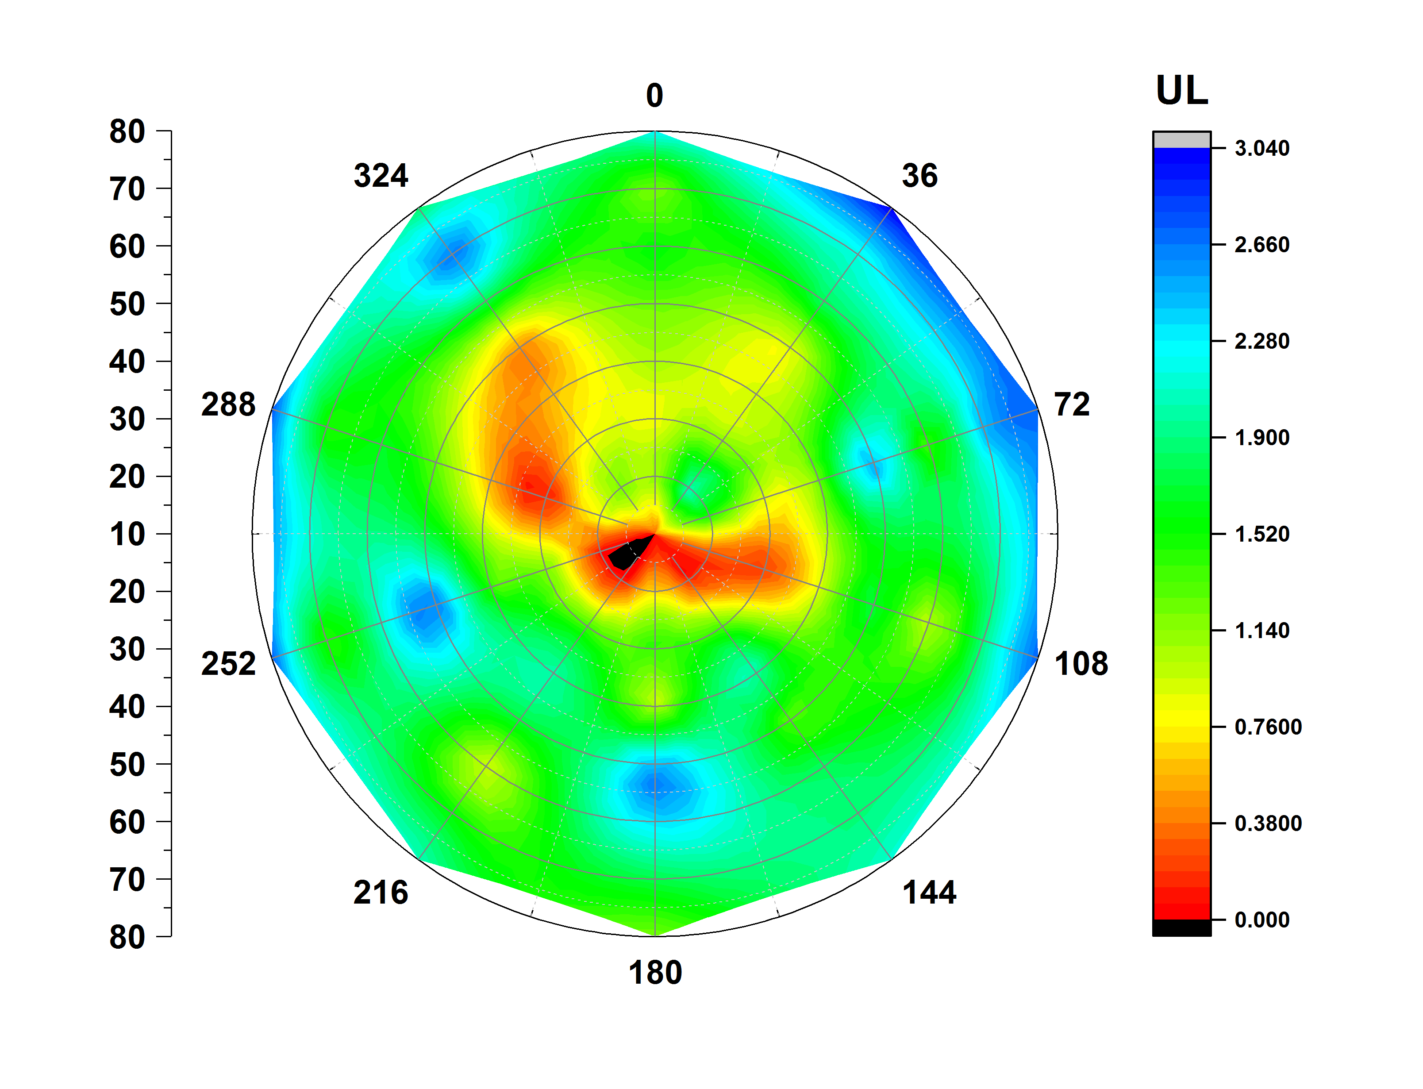
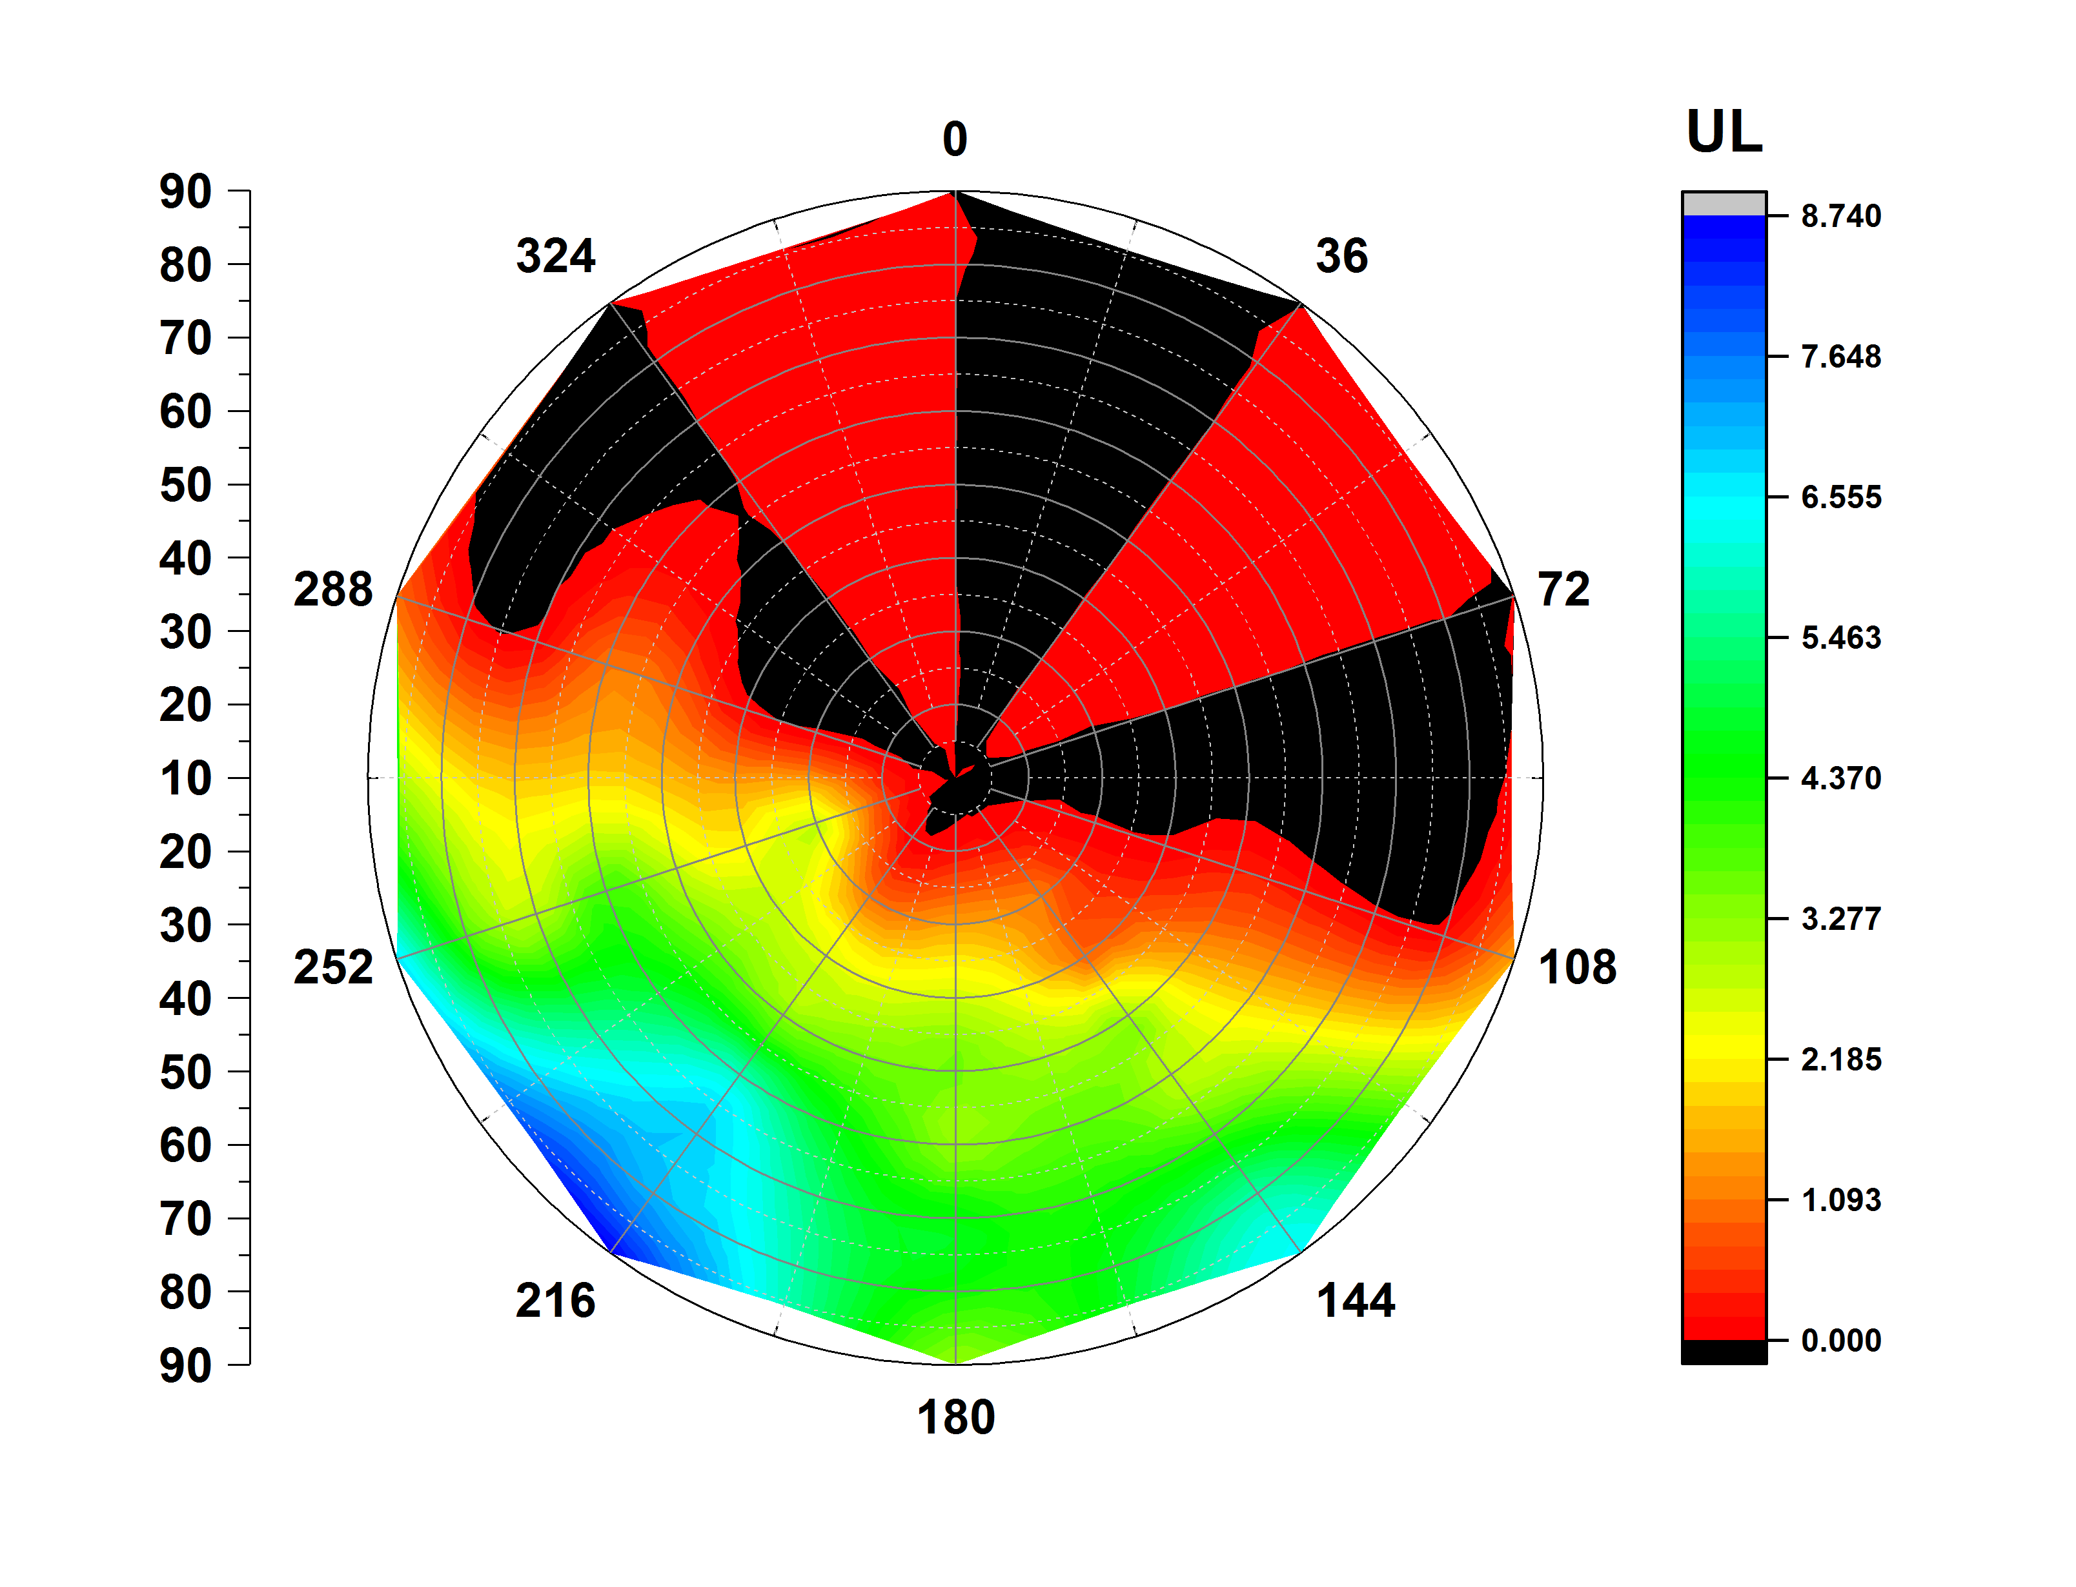
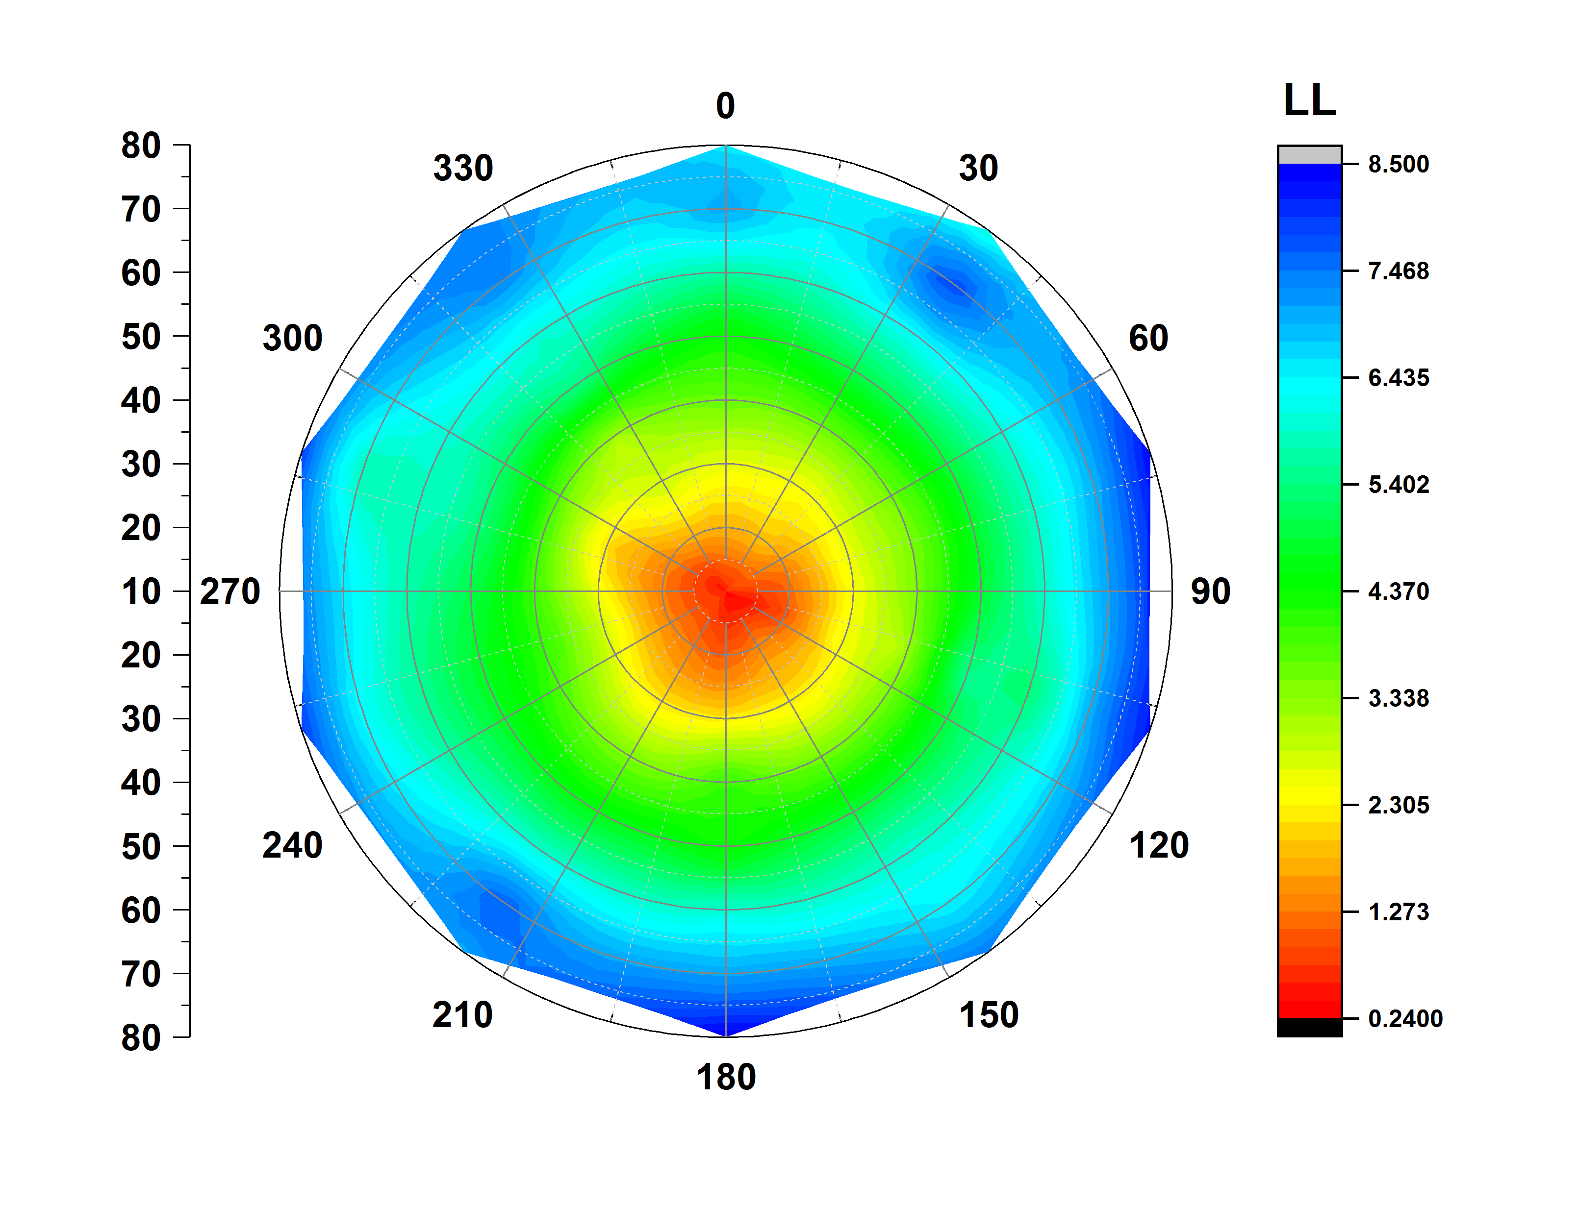
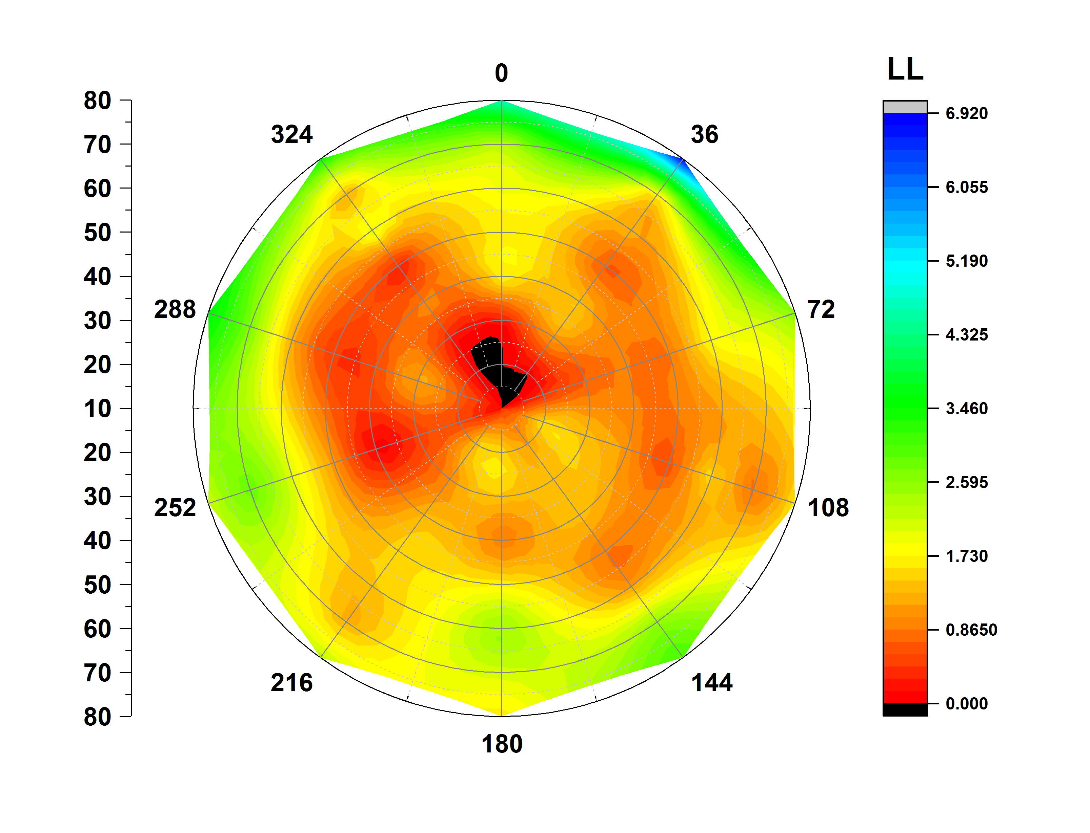
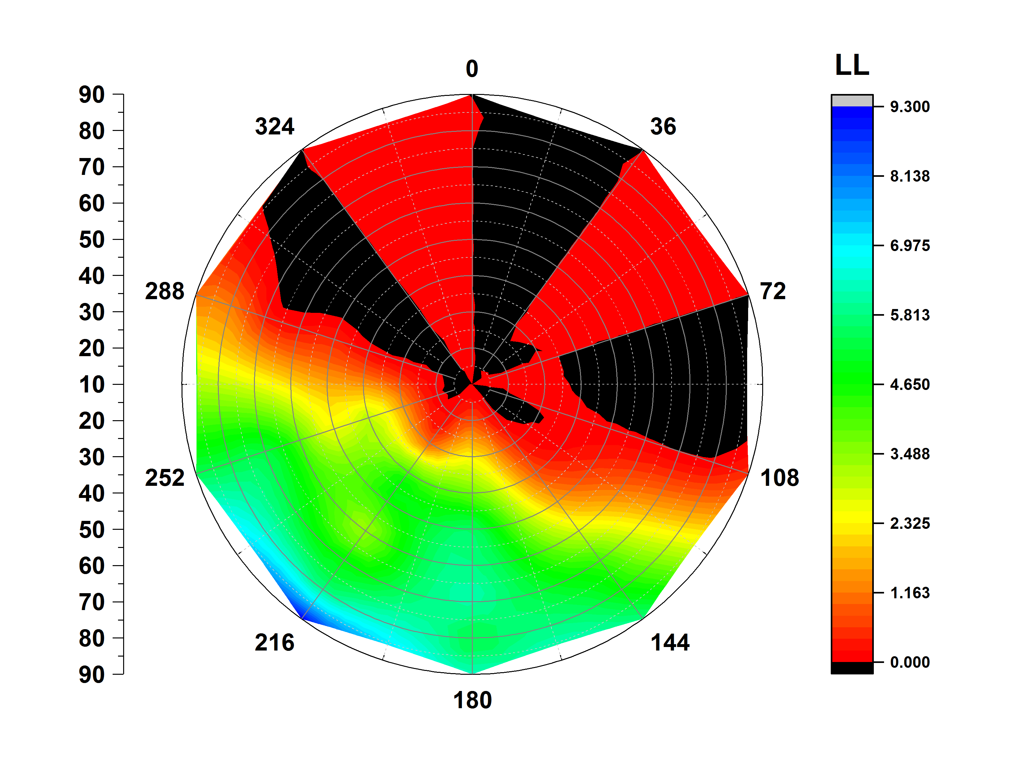
Asymmetric lipid bilayer (POPC/CHL)
AVERAGED OVER 100ns OF MOLECULAR DYNAMICS SIMULATIONS (~ 1 month)
POPC
CHL
CHL
UPPER LEAFLET
LOWER LEAFLET
WELL SPREAD CHOLESTEROL
CHOLESTEROL DOMAIN

Slide 15
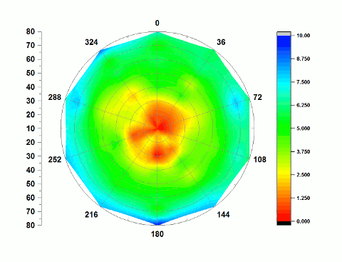
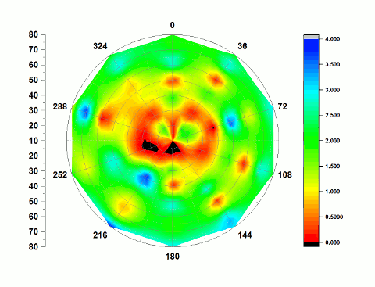
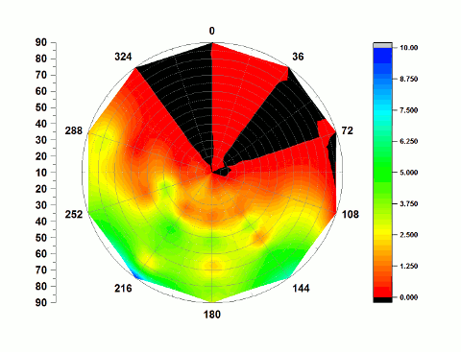
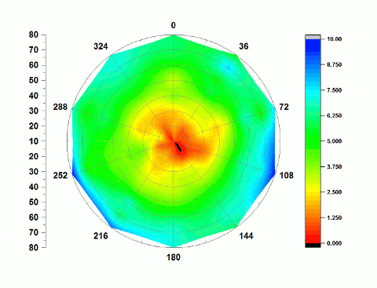
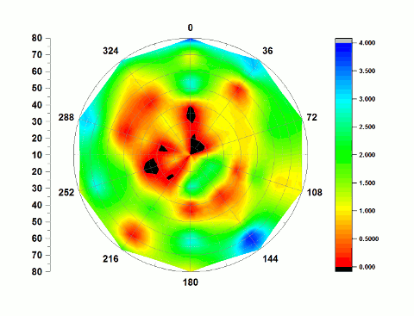
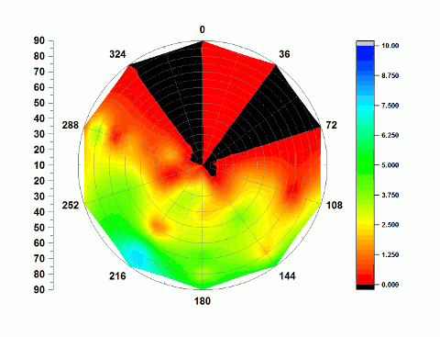
Time evolution
100ns OF MOLECULAR DYNAMICS SIMULATIONS (~ 1 month)
POPC
CHL
CHL
UPPER LEAFLET
LOWER LEAFLET
WELL SPREAD CHOLESTEROL
CHOLESTEROL DOMAIN

Slide 16
Local Membrane Properties

Slide 17
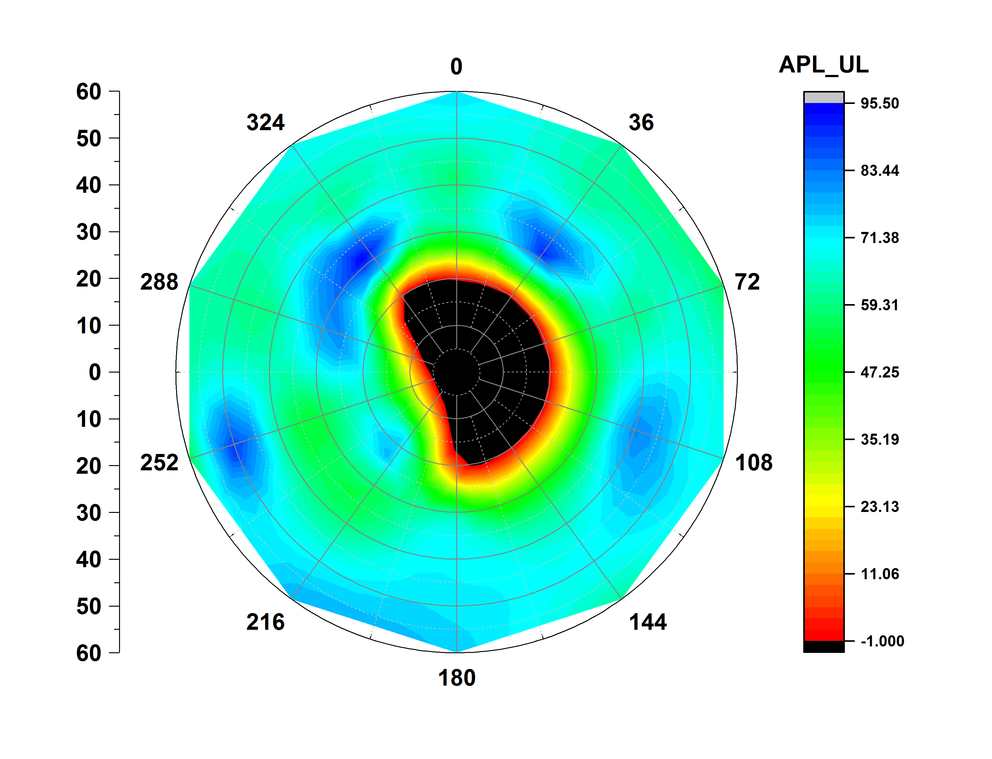
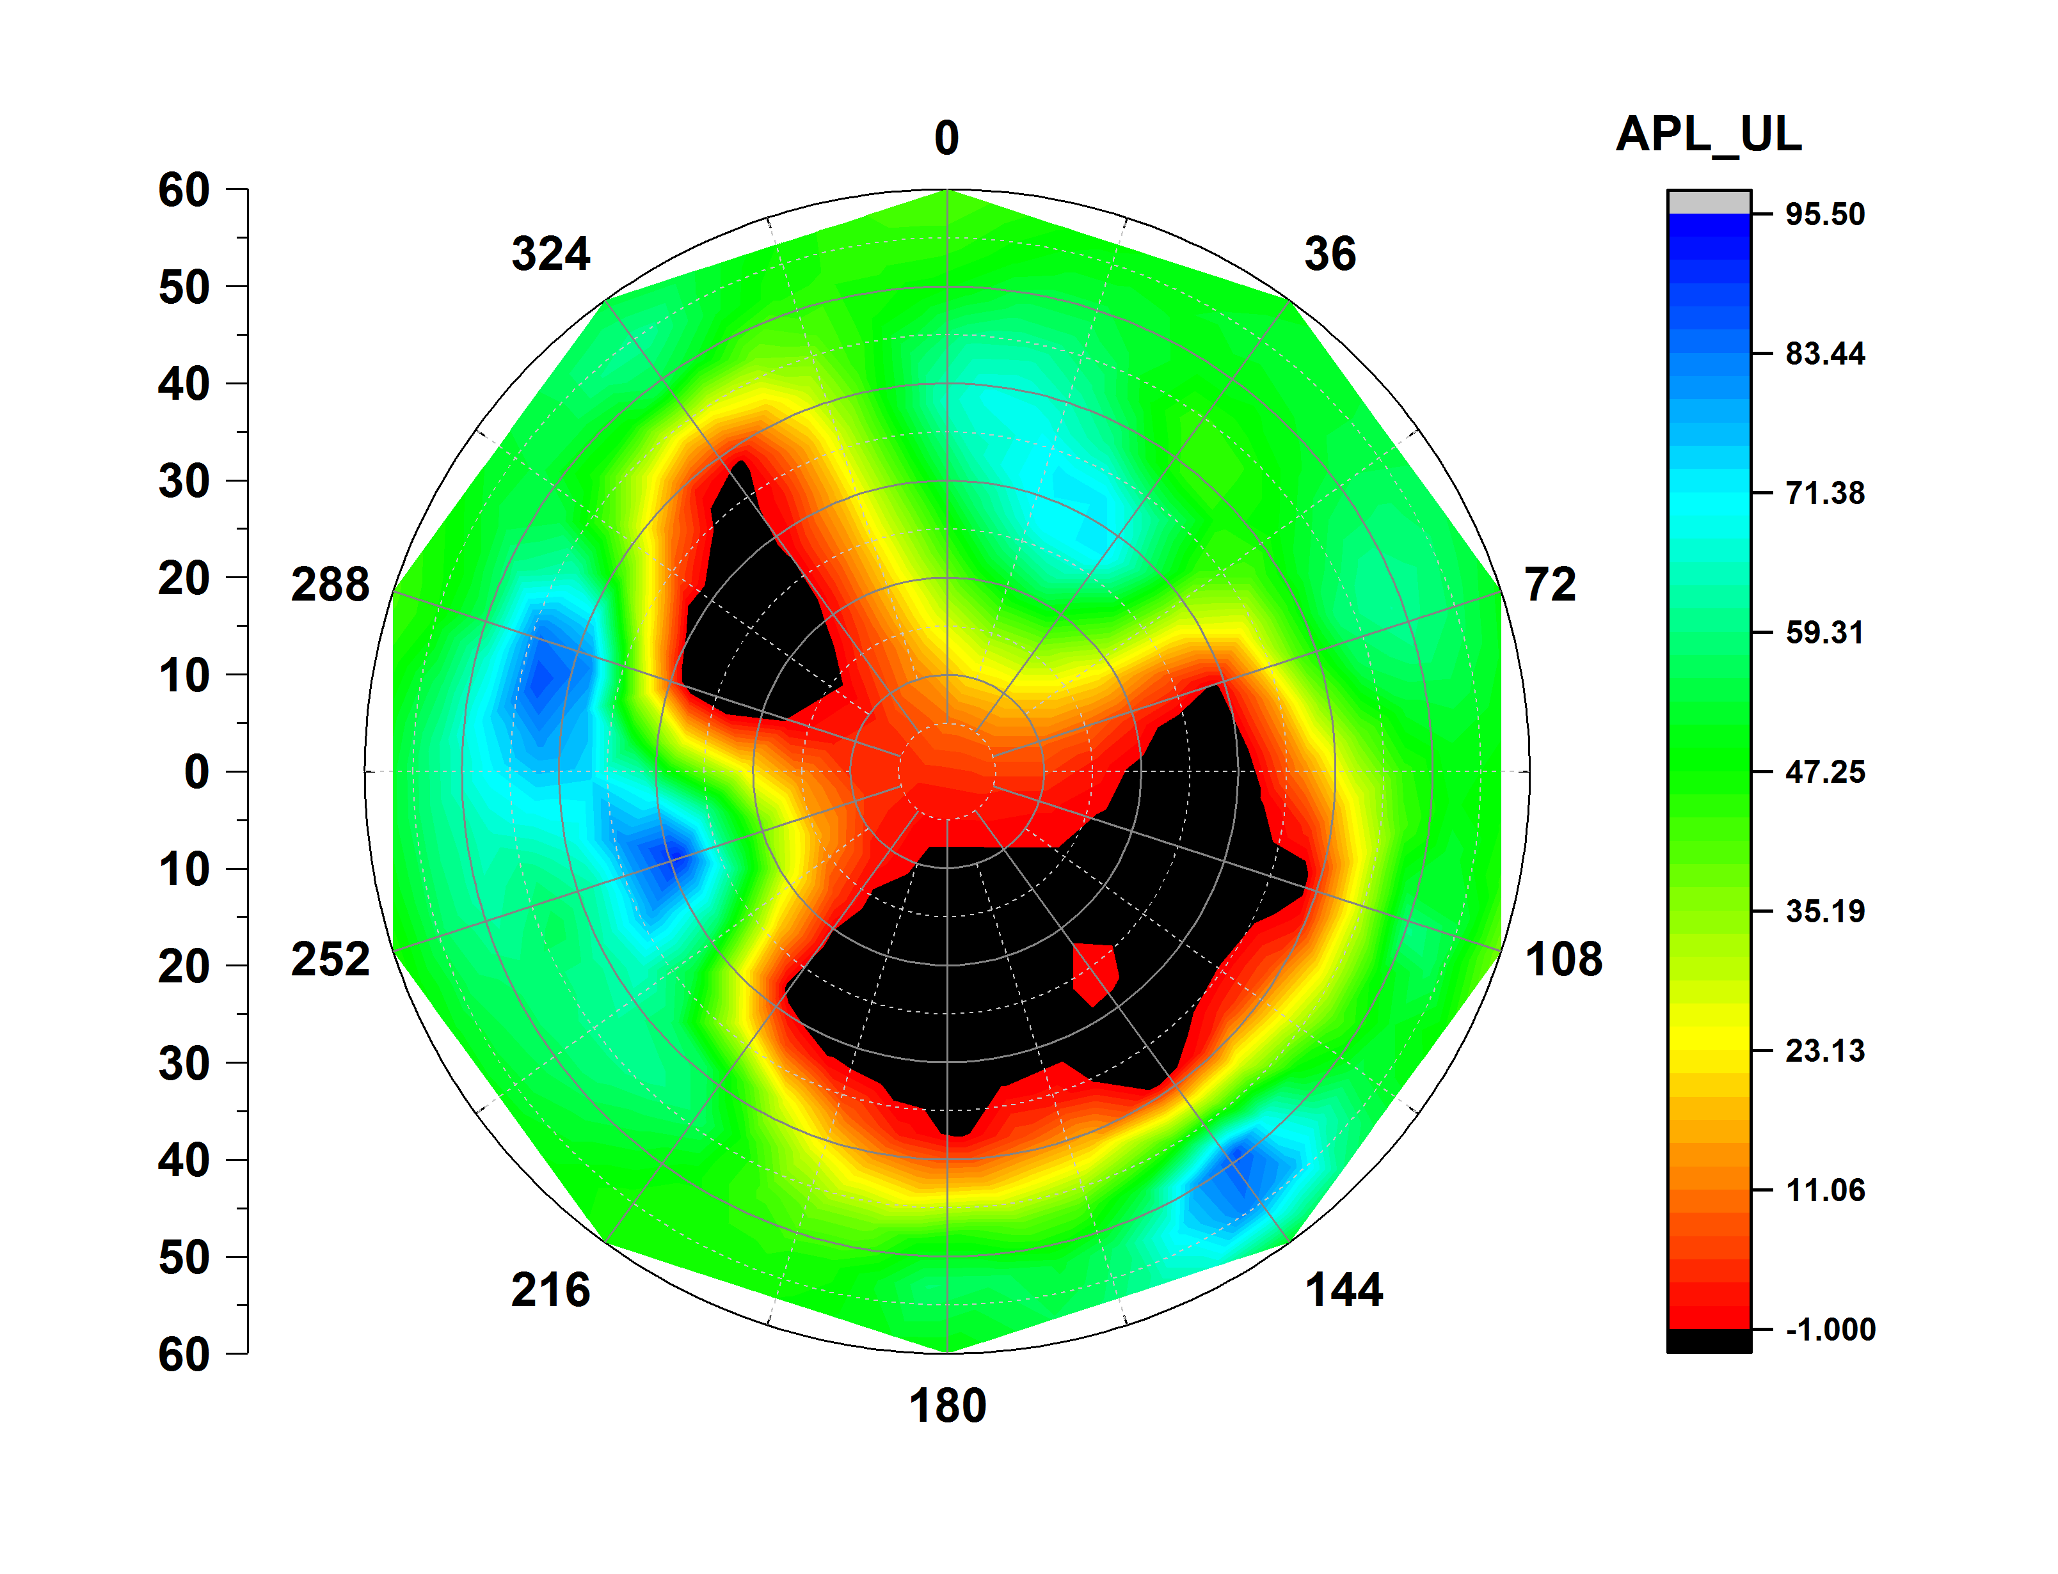
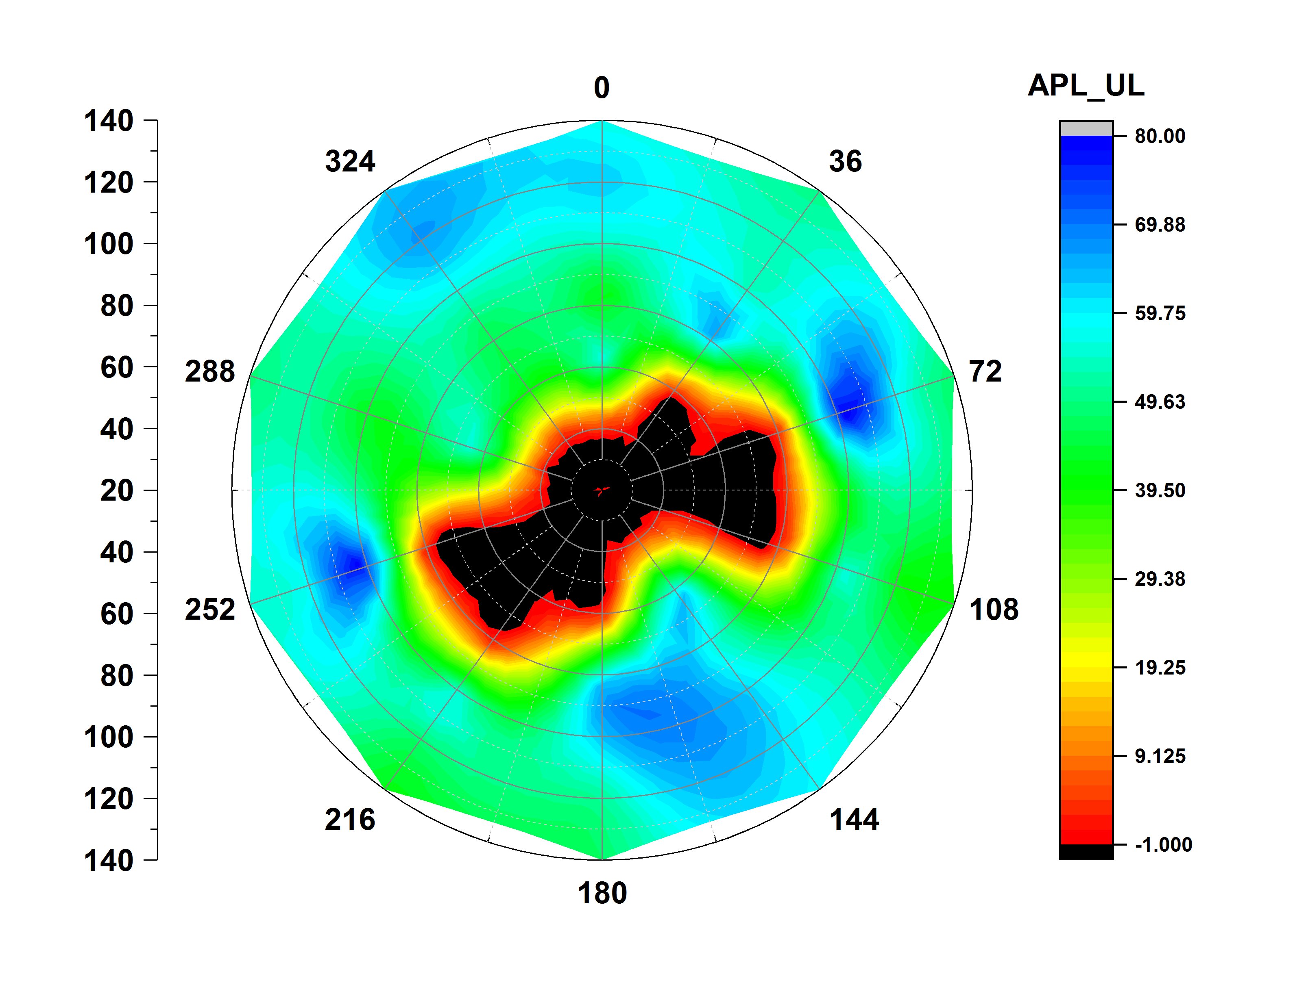
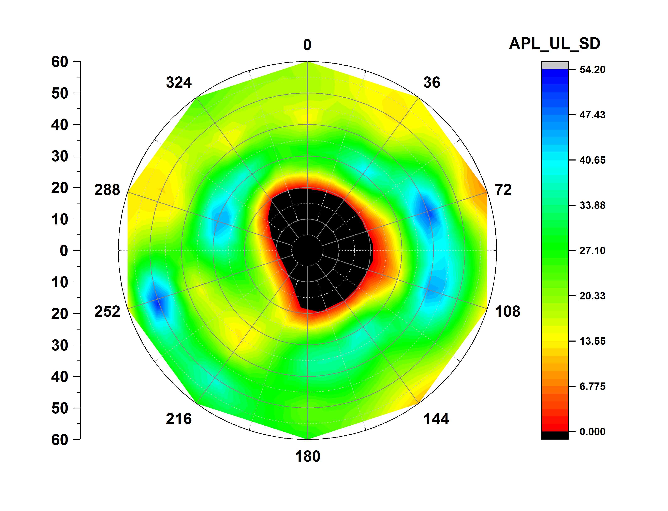
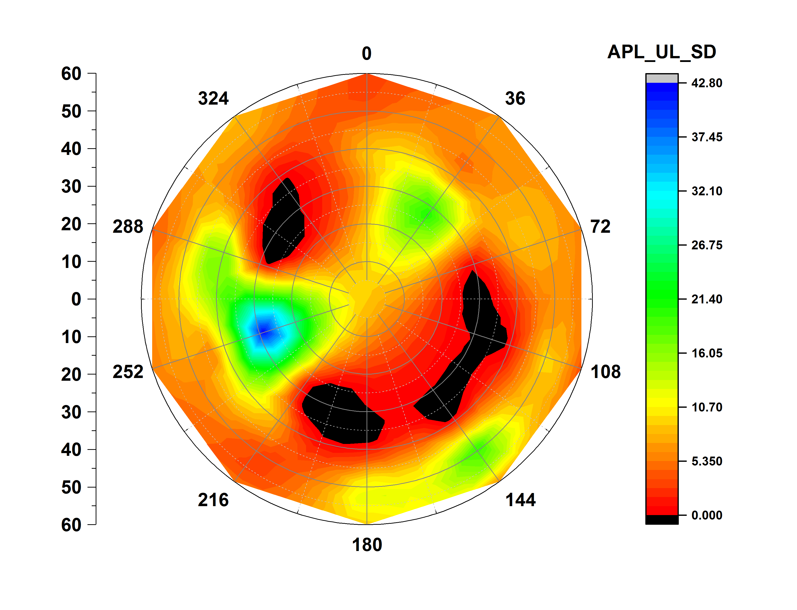
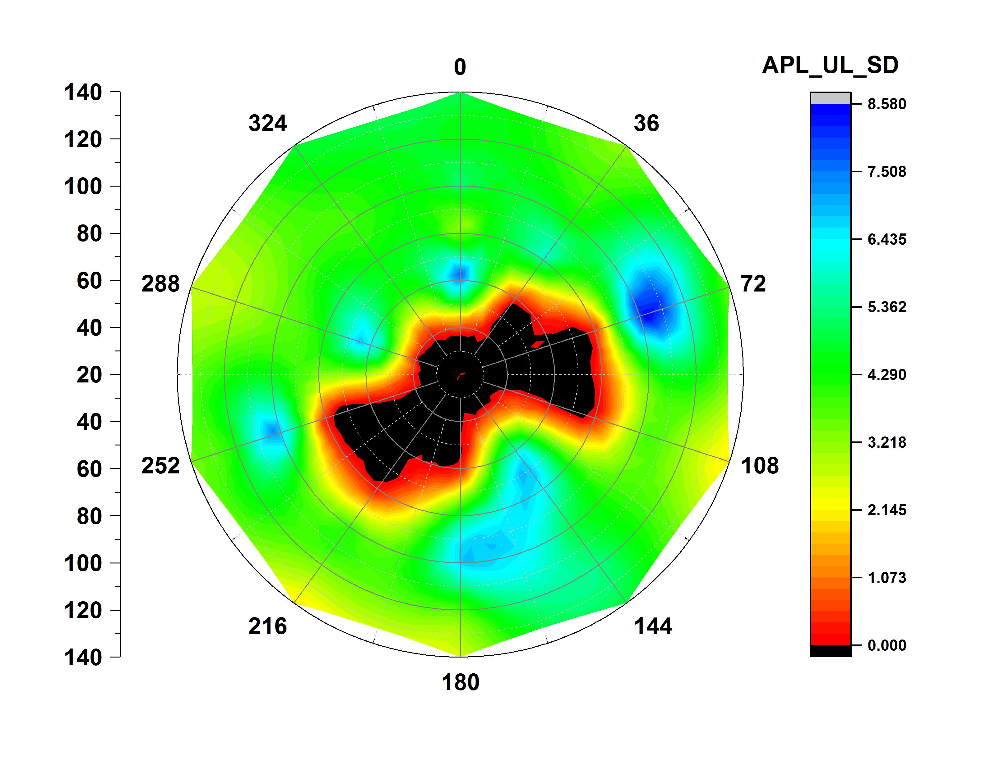
Area per lipid upper leaflet
CXCR4 CHEMOKINE RECEPTOR (3ODU)
ATP SYNTHASE (1C17)
PHOTOSYSTEM 2 ( 3WU2)

Slide 18
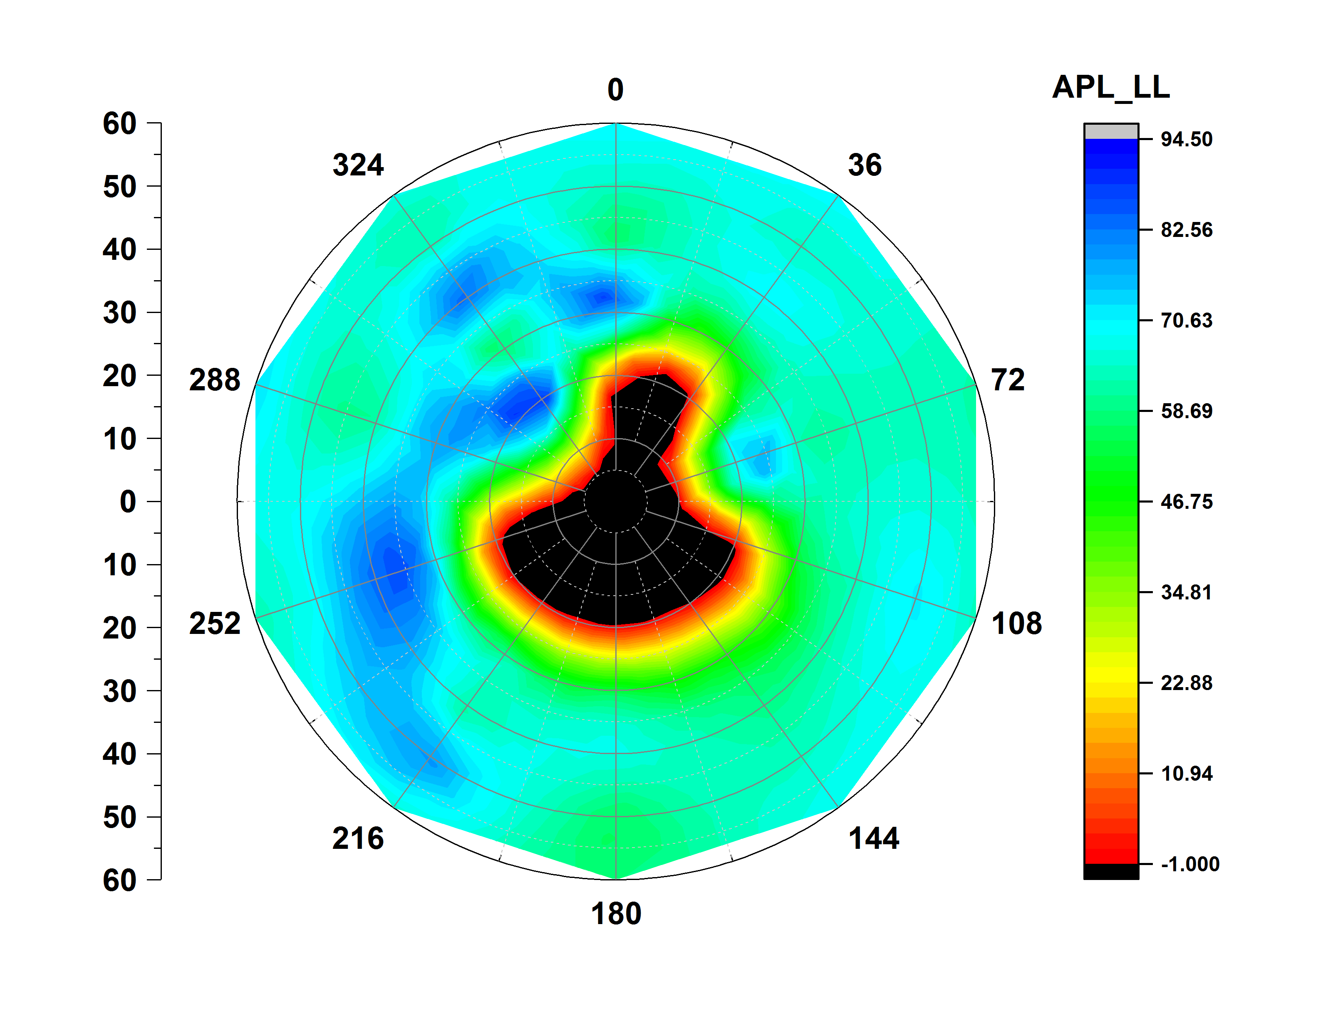
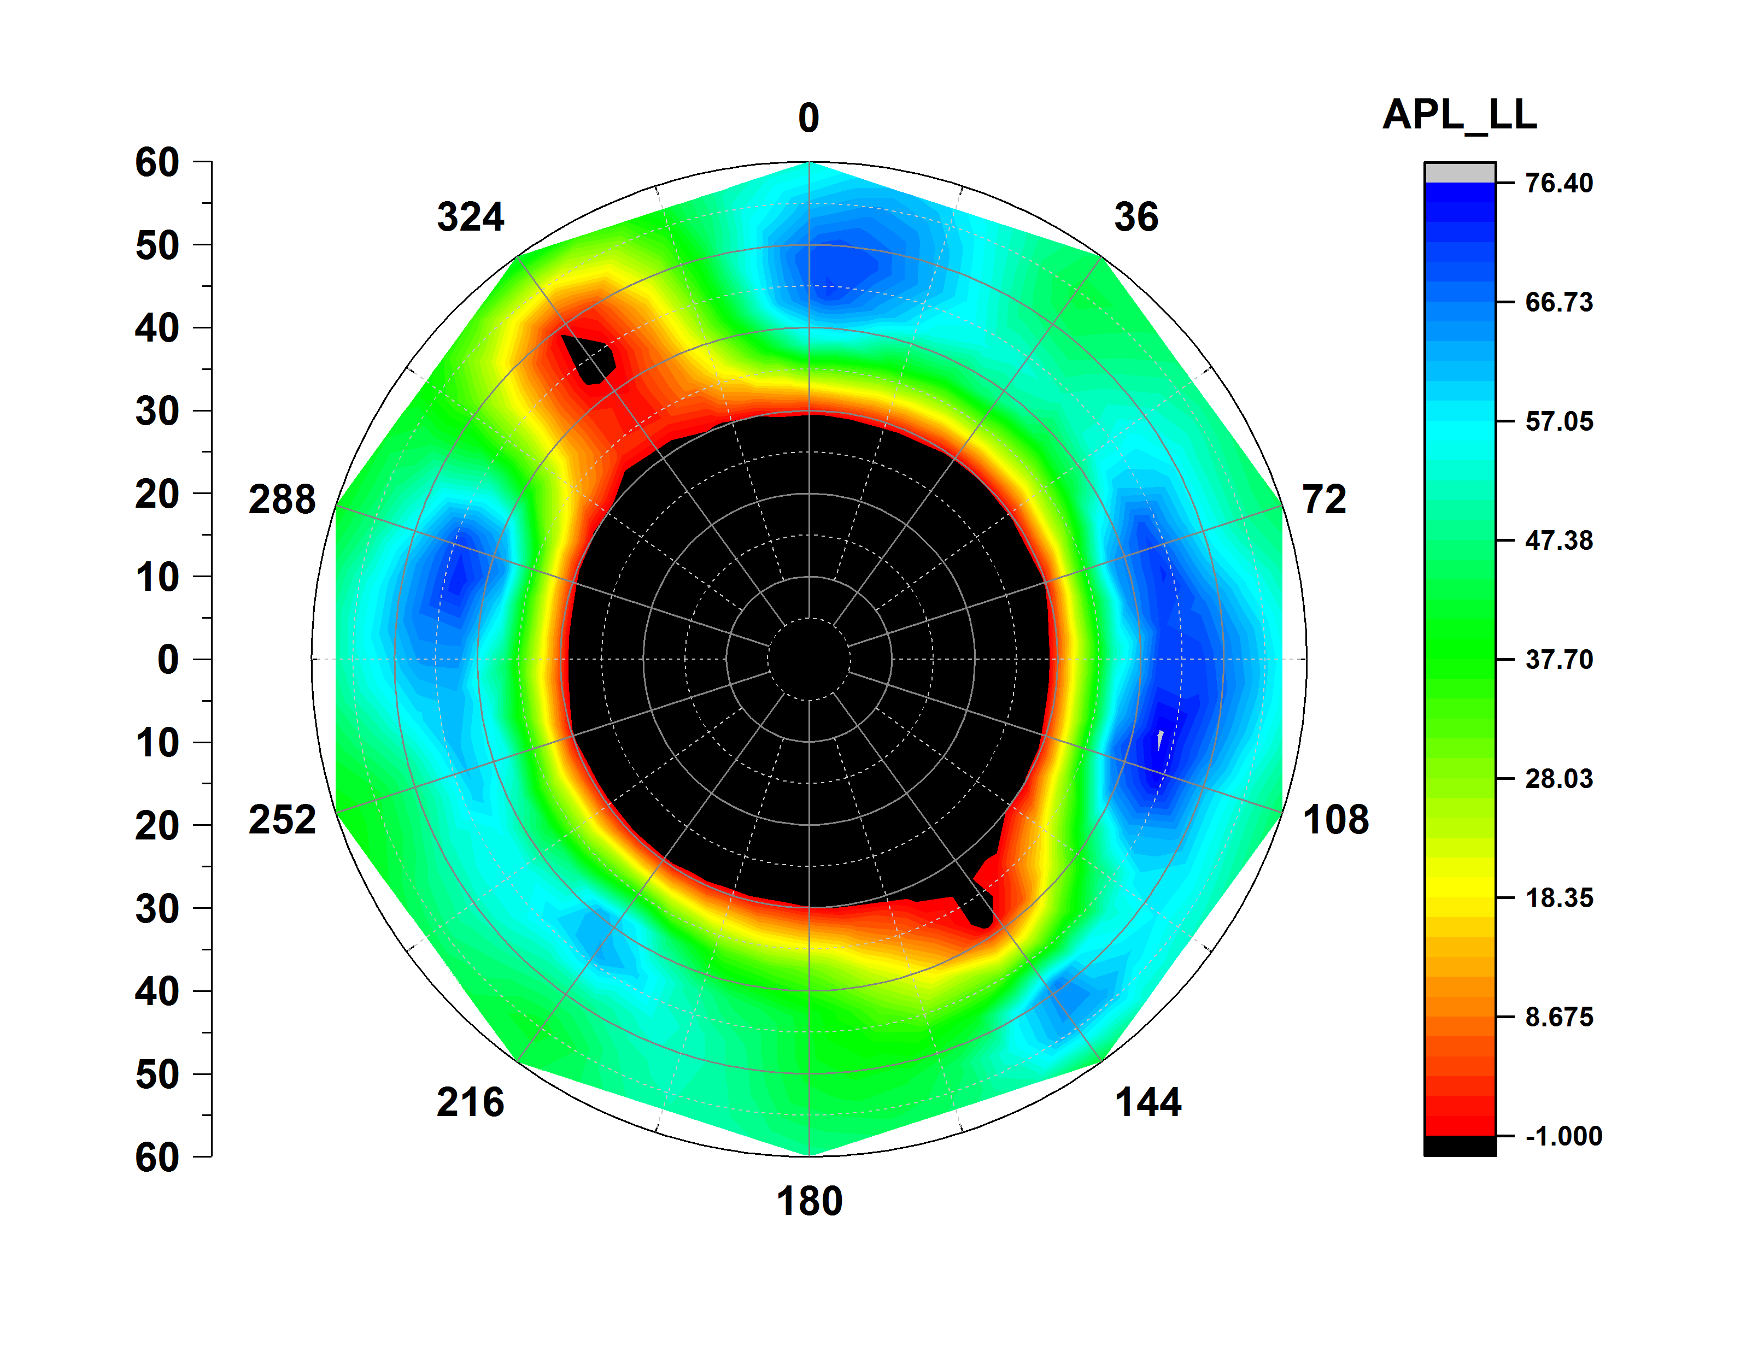




Area per lipid lower leaflet
CXCR4 CHEMOKINE RECEPTOR (3ODU)
ATP SYNTHASE (1C17)
PHOTOSYSTEM 2 ( 3WU2)

Slide 19






Bilayer Thickness
CXCR4 CHEMOKINE RECEPTOR (3ODU)
ATP SYNTHASE (1C17)
PHOTOSYSTEM 2 ( 3WU2)

Slide 20

Bilayer Thickness (Time Evolution)
CXCR4 CHEMOKINE RECEPTOR (3ODU)
ATP SYNTHASE (1C17)
PHOTOSYSTEM 2 ( 3WU2)

